Slide 1
Gla-300 in patients with type 1 diabetes: Overview of meta-analysis of 6-month phase 3 clinical trials

Slide 2
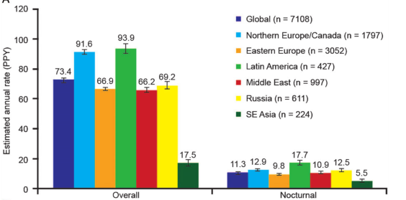
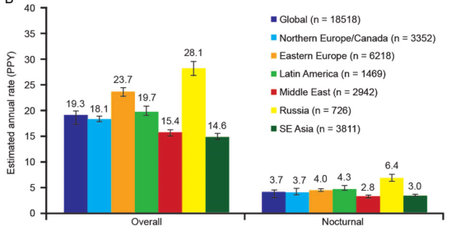
High hypoglycemia rates with insulin therapy and adverse impact
T1DM*
T2DM*
Overall: 73.4 events/patient-year
14.4% reported a severe event
Overall: 19.3 events/patient-year
8.9% reported a severe event
Hypoglycemia incurs morbidity and increased health care utilization
Hypoglycemia is a limiting factor in achieving good glycemic control
Non-interventional 6-month retrospective and 4-week prospective global HAT study of 27,585 patients with T1DM or T2DM treated with insulin for <12 months from 24 countries
*During the prospective period Khunti K et al. Diabetes Obes Metab. 2016;18:907-15
Notes:
Rates of hypoglycemia are high
Slide taken from Gla-300 value deck – slide 2

Slide 3
The possibility of hypoglycemia may limit treatment intensification
I would treat my patients more aggressively if there was no concern about hypoglycemia
Primary care physicians
Specialists
Proportion of healthcare professionals, %
Insulin regimens with lower risk of hypoglycemia may potentially lead to improvements in glycemic control
International Global Attitudes of Patients and Physicians in Insulin Therapy internet survey: 1,250 physicians who treat patients with T1DM and T2DM
Adapted from Peyrote M et al. Diabet Med. 2012;29:682-689
Notes:
70-80% of physicians would consider the target of their patients tightly if there was no concern about hypoglycemia
Slide taken from Gla-300 value deck – slide 2

Slide 4
Evolution of basal insulin development: Overcoming limitations
Insulin glargine 100 U/mL (Gla-100) and insulin detemir were developed to overcome some limitations of early basal insulins such as NPH insulin, with less variable absorption and longer duration of action^{1,2}
Longer-acting basal insulins, insulin glargine 300 U/mL (Gla-300), has since been developed with less variability and more prolonged durations of action (>24 h)^{1,2}
NPH insulin
Relative insulin effect
Relative insulin effect
Insulin detemir
Gla-100
Gla-100
0
12
24
0
12
24
Time, h
Time, h
Relative insulin effect
Gla-100
Gla-300
0
12
24
Time, h
Comparison of action after a single dose for NPH and Gla-100 and for Gla-100 and insulin detemir; comparison at steady state for Gla-100 and Gla-300 and for Gla-100 and insulin degludec NPH, neutral protamine Hagedorn 1. Eliaschewitz FG, Barreto T. Diabetol Metab Syndr. 2016;8:2; 2. Adapted from Pettus J et al. Diabetes Metab Res Rev. 2016;32:478-96
Notes:
Overcoming limitations in basal insulins
Clinical benefits of an ideal PK/PD profile
Slide taken from Gla-300 value deck – slide 2

Slide 5
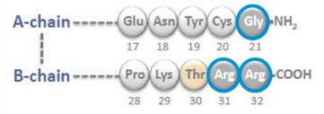
Compact depot formation results in more gradual insulin release
More compact SC depot with smaller surface area^{1,2}
More gradual and slower release from depot surface¹⁻⁴
Insulin glargine
For illustrative purposes only
1. Pettus J et al. Diabetes Metab Res Rev. 2016;32:478-96; 2. Steinstraesser A et al. Diabetes Obes Metab. 2014;16:873-6; 3. Becker RH et al. Diabetes Care. 2015;38:637-43

Slide 6
Low within-day and between-day fluctuation with Gla-300
Gla-300: Low within-day distribution of GIR-AUC as 6- and 12-hour fractions of total AUC
3
53%
47%
Clamp 1
2
Clamp 2
GIR, mg/kg/min
Average GIR
1
24%
23%
29%
23%
0
0–6 h
6–12 h
12–18 h
18–24 h
Gla-300: Low between-day fluctuation
Clamp 1
20
Clamp 2
10
INS, μU/ml
0
<LLOQ
0
6
12
18
24
Time, h
AUC, area under the curve; INS, serum insulin concentration; LLOQ, lower limit of quantification Adapted from Becker RH et al. Diabetes Obes Metab. 2015;17:261-7 (main article and Supplementary Table 1)

Slide 7
Gla-300 characteristics: Conclusions
With Gla-300:
A more compact and smaller depot, which leads to:
More gradual and slower release of insulin from the surface of the depot
More constant and prolonged glucose-lowering profile, maintaining blood glucose control beyond 24 hours¹
Low within-day fluctuation and between-day variability²
1. Becker RH et al. Diabetes Care. 2015;38:637-43; 2. Becker RH et al. Diabetes Obes Metab. 2015;17:261-67

Slide 8
Lower risk for severe hypoglycemia with Gla-300 vs Gla-100 in patients with type 1 diabetes: a meta-analysis of 6-month phase 3 clinical trials
Danne T, et al. Pediatr Diabetes 2019;20 (Suppl 28):P236.

Slide 9
Introduction
T1D meta-analysis
Basal bolus insulin therapy is fundamental to management of T1D, but despite increasing use of diabetes technologies many patients fail to achieve HbA1c targets¹
Fear of hypoglycemia and lack of insulin titration are frequent reasons for not attaining glycemic goals in patients with T1D^{2,3}
Three randomized controlled open-label phase 3 trials have been conducted with insulin glargine 300 U/ml (Gla-300) versus insulin glargine 100 U/ml (Gla-100) in patients with T1D⁴⁻⁶
All three trials had a similar design for regulatory purposes and achieved their primary objective of HbA1c non-inferiority of Gla-300 versus Gla-100⁴⁻⁶
Danne T, et al. Pediatr Diabetes 2019;20 (Suppl 28):P236.

Slide 10
T1D meta-analysis
Objective: This meta-analysis explores the risk for severe hypoglycemia with Gla-300 versus Gla-100 in the pool of studied patients with T1D
Severe hypoglycemia definition
In adults as hypoglycemic event that required assistance of another person to actively administer carbohydrate, glucagon, or other resuscitative actions⁷
In children and adolescents as having altered mental status and inability to assist in their care, being semiconscious or unconscious, or in coma ± convulsions that may require parenteral therapy (glucagon and/ or glucose) ⁸
Danne T, et al. Pediatr Diabetes 2019;20 (Suppl 28):P236.

Slide 11
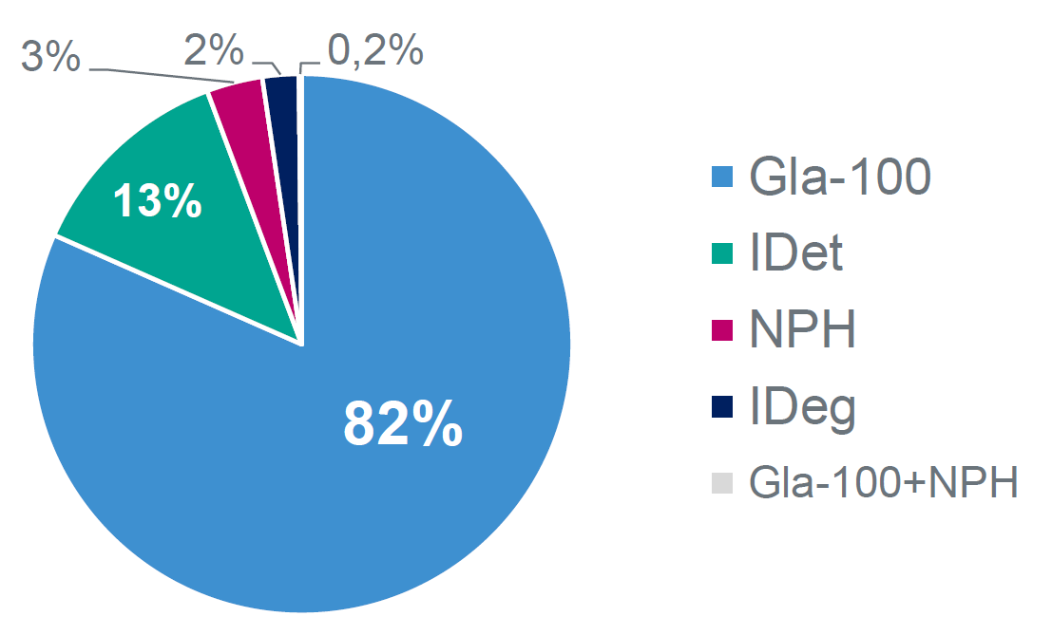
Study design and previous basal insulin use
T1D meta-analysis
The following patients with T1D were pooled in the present study:
− EDITION 4 (n=549): adult patients (age ≥18 years), worldwide⁹
− EDITION JP 1 (n=243): adult patients (age ≥18 years), Japan¹⁰
− EDITION JUNIOR (n=463): children and adolescents (age 6−17 years), worldwide¹¹
Study design
Previous basal insulin
Danne T, et al. Pediatr Diabetes 2019;20 (Suppl 28):P236.

Slide 12
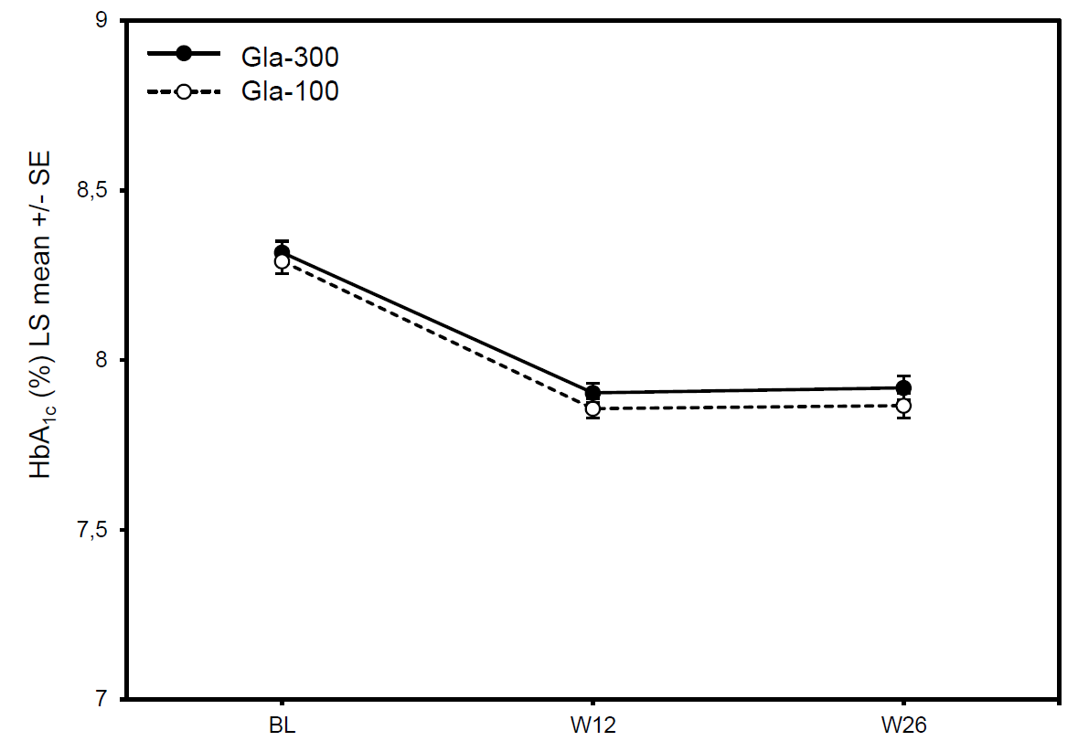
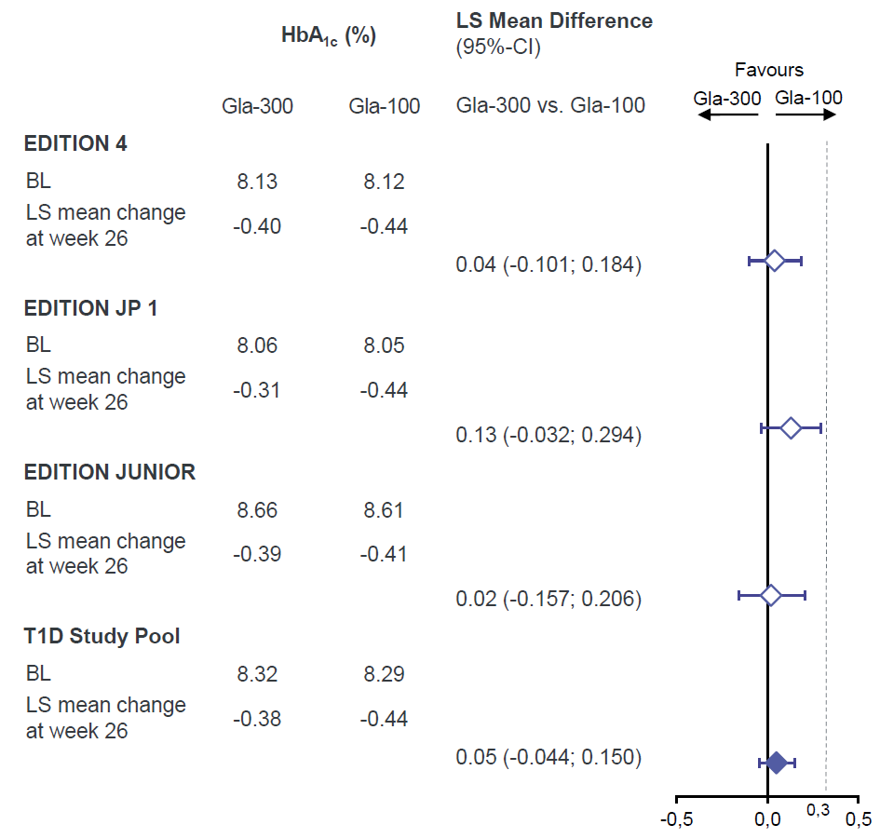
HbA_{1c} reduction from baseline to week 26
T1D meta-analysis
HbA_{1c} reduction with Gla-300 was non-inferior to Gla-100 across trials at the 0.3% margin
Danne T, et al. Pediatr Diabetes 2019;20 (Suppl 28):P236.

Slide 13
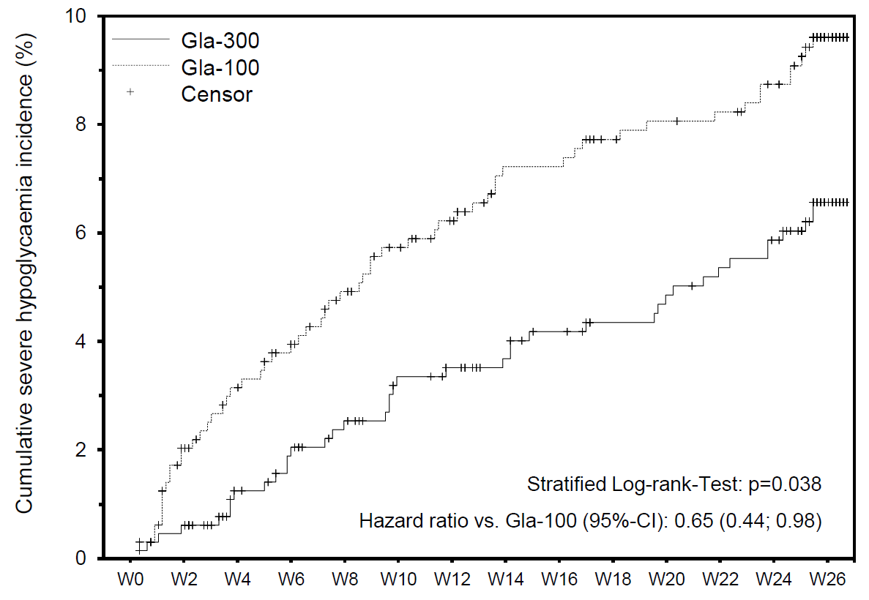
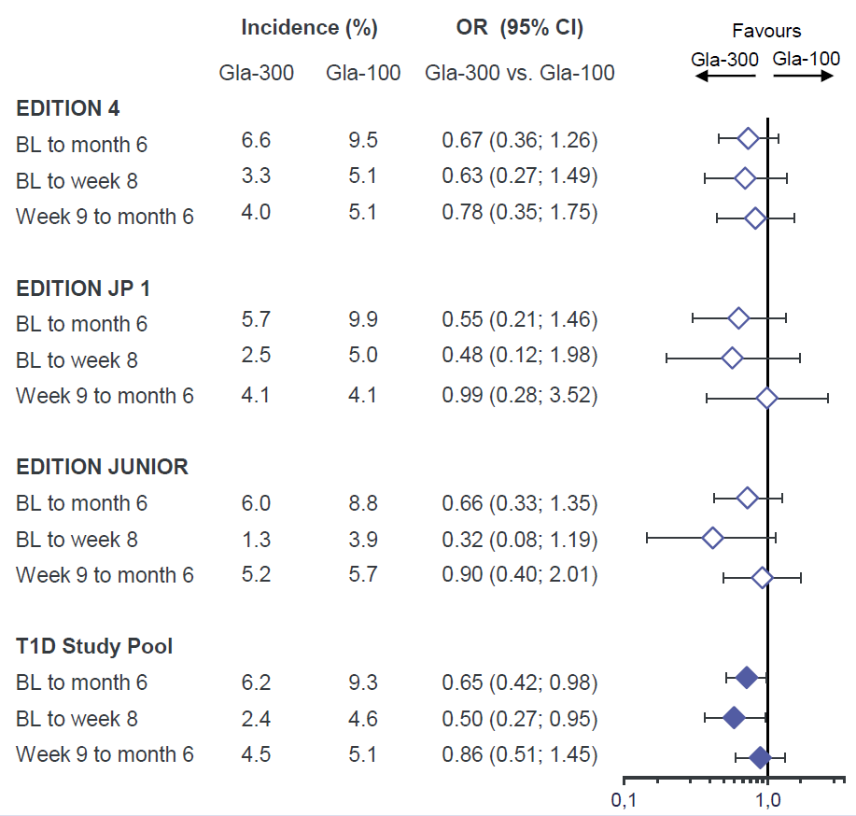
Lower percentage of patients with ≥1 severe hypoglycemic event with Gla-300 vs. Gla-100 from baseline to month 6
T1D meta-analysis
Severe hypoglycemia incidence (%)
Fewer patients experienced severe hypoglycemic events with Gla-300 versus Gla-100
Danne T, et al. Pediatr Diabetes 2019;20 (Suppl 28):P236.

Slide 14
Discussion/Conclusion:
T1D meta-analysis
Gla-300 provides effective and similar glycemic control versus Gla-100 in patients with T1D
Treatment with Gla-300 was associated with a lower risk for severe hypoglycemia compared with Gla-100, especially during the titration phase
Although the risk of severe hypoglycemia was similar with Gla-300 and Gla-100 in the maintenance phase, the data indicate that Gla-300 offered important advantages during active titration
Limitations:
The T1D study pool consisted of heterogeneous populations that may, however, represent a large multi-national cohort of patients with T1D eligible for Gla-300
The analysis was performed post-hoc and is exploratory in nature
Gla-300 showed a lower risk for severe hypoglycemia compared with Gla-100 in a broad spectrum of patients with T1D, especially during the titration phase
Danne T, et al. Pediatr Diabetes 2019;20 (Suppl 28):P236.

Slide 15
DOSAGE & ADMINISTRATION
General Instructions:
Basal Insulin
Once a Day
SC injection at any time of the day
When needed, patients can administer Toujeo up to 3 hours before or after their usual time of administration
Dosage ranges from 1 to 80 U / one injection
Toujeo should not be administered intravenously.
Toujeo must not be mixed with any other insulin or diluted. Mixing or diluting can change its time/action profile and mixing can cause precipitation
The advantage of dosing flexibility
when needed

Slide 16
Administration
Initiation :
T1DM:
Once-daily with meal-time insulin and requires individual dose adjustments.
T2DM:
The recommended daily starting dose is 0.2 units/kg followed by individual dose adjustments
Switch between Lantus to Toujeo :
Switching from insulin Lantus to Toujeo, can be done on a unit-to-unit basis.
Switch from other basal insulins to Toujeo:
Switching from once-daily basal insulins to once-daily Toujeo can be done unit-to-unit based on the previous basal insulin dose.
Switching from twice-daily basal insulins to once-daily Toujeo, the recommended initial Toujeo dose is 80% of the total daily dose of basal insulin that is being discontinued.

Slide 17
Storage
Before first use
Store in a refrigerator(2-8°C)
Do not freeze or place next to the freezer compartment or a freezer pack.
Keep the pre-filled pen in the outer carton in order to protect from light.
After first use
The product may be stored for a maximum of 6 weeks below 30°C. Do not refrigerate. Put the pen cap back on the pen after each injection in order to protect from light.

Slide 18
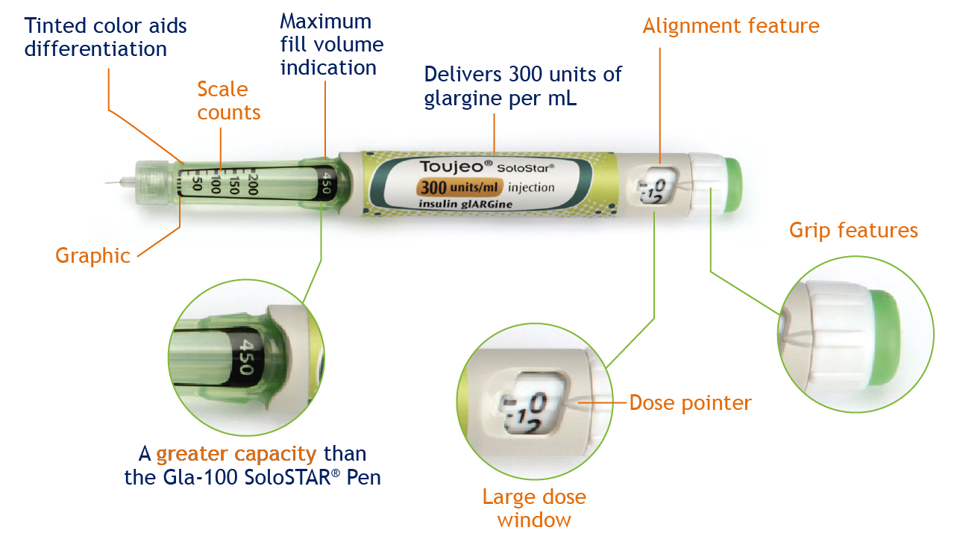
Usability of the Gla-300 SoloSTAR® Pen
Redesigned features
Features of the Gla-300 SoloSTAR ® Pen
1 click =
1 dose
450 units of insulin
Toujeo EU SmPC Jul 09-2017
Pohlmeier H et al. 2016 - Journal of Diabetes Science and Technology - DOI: 10.1177/1932296816668877 - Ease of Use of insulin Gla-300 Pen Injector in Insulin-Naïve People with T2DM Klonoff and al. 2016 - Journal of Diabetes science and Technology - DOI: 10.1177/1932296815601441 - Accuracy and Injection Force of the Gla-300 Injection Device Compared With Other Commercialized Disposable Insulin Pens
Notes:
VOICE OVER/LESSON
Now here are the features of the Gla-300 SoloSTAR® Pen.
As you can see on this picture, certain features have been enhanced to improve user experience.
Features of the Gla-300 SoloSTAR® Pen include: a greater capacity than the Gla-100 SoloSTAR® Pen: 450 units versus 300 units (apparition ovale “450 units of insulin”), and modifications to ensure that 1 click of the dose selector corresponds to 1 unit of Gla-300 (apparition de l’autre ovale vert “1 click= 1 dose”), so there is no need for recalculation to account for the lower injected volume.
POPUP COMMENTS
Grip features: Dose button designed to avoid blocking during dispense
Large dose window: It shows number of units: no recalculation is needed to account for the low injected volume
Alignment feature: Unit dose adjustment (1 click = 1 unit) and maximum single dose of 80 units: the same as the Gla-100 SoloSTAR® Pen
Dose pointer: Even numbers shown in line with dose pointer
Greater capacity: Contains 50% more insulin than the Gla-100 SoloSTAR® Pen: 450 units versus 300 units
Graphic: Clearly different graphic at 0 units aids identification in instruction leaflet
Scale counts: Scale counts in 50s
REFERENCES
Pohlmeier H et al. Poster presentation at ADA 2015; Abstract 1052-P Klonoff D et al. J Diabetes Sci Technol. 2015;9:936-8 (Letter to the Editor)

Slide 19
Thank You

