Slide 1
M.Hashemipour
Pediatric Endocrinologist
Isfahan University of Medical Sciences
Endocrine &metabolic research center
Child growth &development research center
Graves disease-induced
Thrombotic thrombocytopenic purpura

Slide 2


Slide 3
A 16-year-old girl initially presented with
General fatigue, palpitations, and excessive sweating ,weight loss
No significant medical history
There is strong family history of thyroid disease
She tends to easily get tired when does excessive exercise
There is no history of recent illness or infection

Slide 4
She was seen by her primary care physician about 1 month ago for poor sleep quality and mood swings
She was noted to have pulse rate of 140 beats/min and blood pressure of 130/52 mm Hg.

Slide 5
Physical examination
Cardiopulmonary examination was unremarkable
There was no hepatosplenomegaly, no skin changes, Normal muscle tone and power.
She has a nontender, symmetric goiter.
No upper eyelid retraction, scleral erythema, or proptosis.
Her weight was 50 kg

Slide 6
Which evaluations are needed?

Slide 7
Lab evaluation
Serum TSH has the highest sensitivity and specificity for assessing TH excess.
Should be used as an initial screening test
Accuracy improves when TSH and free T4 are assessed at the time of the initial evaluation.

Slide 8
Question
Do we need additional test to confirm diagnosis before starting treatment ?

Slide 9
TSH-R-Ab
Most clinicians would request thyroid ultrasound and less often isotope scanning

Slide 10
TSH Receptor Antibody
TSH-R-Ab are specific biomarker for diagnosis of graves' disease
  95 % of clinical GD will have positive TRAB
TRAb is a highly sensitive and predictive biomarker for the extrathyroidal manifestations of GD as well as a useful predictive measure of fetal or neonatal hyperthyroidism.
incorporation and early utilization of TRAb into current diagnostic algorithms conferred a 46% shortened time to diagnosis of GD and a cost saving of 47%.

Slide 11
TSH Receptor Antibody
TRAb is a sensitive and specific tool for rapid and accurate diagnosis and differential diagnosis of Graves’ hyperthyroidism.
for prognostic purposes
for monitoring ATD therapy
for timing of stopping therapy
Allows long term ATD therapy in some cases
Execellent predictive value for relaps

Slide 12
Thyroid Peroxidase Antibody
The most sensitive serologic test for detecting autoimmune thyroid disease (AITD)

Slide 13
Laboratory test results
TSH = <0.01 mIU/L
Free T4 =3.2 ng/dL (0.9-1.7 ng/dL)
Total T3 = 350ng/dL (90-240 ng/dL)
TRAB = 20 mU/l (0.27 to 4.2 mU/l)

Slide 14
Key Points before Treatment
Discuss with pt logistics, benefits, speed of recovery, drawbacks, potential side effects and cost
Final decision on choice of treatment depends on resources pt preference and physician experience
Absolute neutrophil counts should exceed 1000/mm3 and liver enzyme should be no higher than three times the upper limit of the normal range

Slide 15
WBC count with differential,liver profile including bilirubin,transaminases, and alkaline phosphatase measured
Absolute neutrophil count (ANC) = 2.3 × 103/μL (4.0-6.5 × 103/μL)
AST = 40 U/L (5-32 U/L)
ALT = 50 U/L (5-33 U/L)

Slide 16
When and How to Treat?

Slide 17
Methimazole was initiated at a dosage of 15 mg daily
Atenolol, half a pill QD

Slide 18
We did FT4 and T3 four weeks later
Free T4 = 2.5ng/dL (0.9-1.7 ng/dL)
Total T3 = 280 ng/dL (90-240 ng/dL)
The dose increased to 20 mg/day

Slide 19
Repeated test After 4 weeks
Free T4 = 2 ng/dL (0.9-1.7 ng/dL)
Total T3 = 250 ng/dL (90-240 ng/dL)

Slide 20
Again the test was repeated after 6 weeks
it was normal
We continued Methimazole

Slide 21
Admission time
After 6 month of initiation of disease
She admitted in our hospital with the complaints of shortness of breath, dizziness, weakness, headache, Fatigue, Malaise. Nausea. Vomiting. Abdominal pain , diarrhea that had progressed over 2 days.
Her vital signs showed a blood pressure of 126/70 mmHg, pulse of 120 beats/minute, respirations of 21/minute, temperature was 38.5°C

Slide 22
On physical examination
She was awake and alert
Hydrated, acyanotic
Had a diffuse and enlarged thyroid gland.
No organomegaly, or lymphadenopathy

Slide 23
Patient course
Her outpatient records two month prior to admission showed
Free T4 =1.4 ng/dl (0.5–1.26 ng/dl)
TSH= 0. 4mIU/ml (0.3–4.5 mIU/ml).
T3= 200 ng/dl (90-240 ng/dL)
CBC = Normal

Slide 24
Patient course
She had stopped taking methimazole 4weeks ago and was advised to follow up with an endocrinologist, but she did not comply
Finally she started methimazole a week before his hospitalization
At that time, outpatient ultrasound showed an enlarged thyroid with increased background vascularity

Slide 25
Patient course
On admission
TSH= <0.01 mIU/L
Free T4 =3.93 ng/dl (0.5–1.26 ng/ dl)
Total T4 =18 μg/dl (5.28–9.27 μg/dl)
T3 = 300 ng/dL (90-240 ng/dL)
So methimazole was continued

Slide 26
Patient course
After a few hours
She was lethargic & pallor
She suffered from Abdominal pain
She had Purpura, Petechi, subicter
She had dark urine

Slide 27
Patient course
The general condition got worse
The patient's tests were as follows
Hemoglobin of 7.9 g/dl
platelets of 40000/μl
Reticulocyte count 5.31%
Unconjugated bilirubin = 3mg/dl

Slide 28
Second day of hospitalization
Her peripheral smear showed many
Schistocytes ,Acanthoses,Nucleated red blood cells, Micro Spherocytes
Direct Coombs test was negative.
Urinalysis Showed Hemoglobinuria ,proteins= ++
Normal PT,PTT
LDH= 1000 IU/L

Slide 29
Second day of hospitalization
D-dimer 1725 = ng/ml (< 501 ng/ml)
Creatinine =1.5mg/dl (0.44–1.0mg/dl)
ADAMTS13 = 200ng/ml 740-1420 ng/ml
AST =300u/l ( 15–40)
ALT =200u/l ( 9–50)
Fibrinogen 250= mg/dl (232–519mg/dl
Stool culture - For pathogenic Escherichia coli=negative

Slide 30
Thrombotic thrombocytopenic purpura
The criteria for diagnosis of TTP were fulfilled
Thrombocytopenia, hemolytic anemia, neurological
abnormalities, fever, and renal dysfunction
Patient was transferred to the intensive care unit for close monitoring
Treatment with plasma exchange should be initiated as soon as possible, preferably within 4–8 h,
plasmapheresis was done for her 7 sessions

Slide 31
Patient course
But complete recovery was not achieved
So methylprednisolone was given in doses 500mg pulse plus 1g for 3days, followed by prednisolone in dose 1mg/kg until remission was achieved, with gradual reduction for 2weeks thereafter.
After 2 weeks of admission, because of partial recovery
we decided to do plasmapheresis three times a week

Slide 32
Patient course
Gradually, partial clinical and paraclinical recovery was achieved
Also hemoglobin &platelets Increased partially
D –dimer, ,creatinine Decreased
All biochemical findings improved partially

Slide 33
Key point
We expect that
Resolution of neurologic changes was 3 days
Normal LDH was 5 days
Normal platelet count was 10 days
Normal kidney function was 15 days

Slide 34
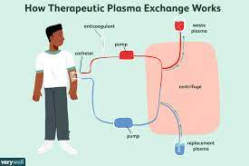
The role of plasmapheresis
Daily PEX is the mainstay of treatment.
It removes
vW multimers
ADAMTS-13 antimetalloproteinase antibodies
Endothelial cytokines
PEX Replete ADAMTS13.

Slide 35
How long do we do plasmapheresis?
Recommend therapy should be sustained until
platelet count reaches 100,000/mm³
LDH levels are below 400 UI/l
These are the most sensitive markers for evaluate the therapeutic response

Slide 36
Patient course
Workup for secondary causes of TTP was also done
All of them were negative
Her antinuclear antibody
Human immunodeficiency virus
Hepatitis profile
Anti-double-stranded DNA
Cardiolipin antibodies
lupus screen
Scleroderma antibodies
Normal complement C3 and C4

Slide 37
Patient course
The patient was discharged with prescription of prednisone 30 mg /day & methimazole
Keeping corticosteroids administration can support complete remission of the disease and outpatient follow up is essential to monitor remission or detect recurrent chronic form
But the disease relapse three times
Most symptoms at the time of admission
Headache, , purpura, weakness, fatigue, tachycardia, jaundice , fever, symptomatic anemia

Slide 38
Patient course
The use of methimazole prior to admission was not thought to be a cause of our patient’s blood cell abnormalities
Because her white blood cell count was normal two month ago
. Drug-induced thrombotic microangiopathy (DITMA) was also ruled out because methimazole has not been reported to cause DITMA.

Slide 39
Drug-induced thrombotic microangiopathy
Chemotherapy drugs
Antiplatelet agents
Quinine
Cyclosporine

Slide 40
Patient course
The patient did not cooperate well and every time she was hospitalized, thyroid function test was abnormal
That's why we decided to change the treatment method
We offered her surgery, but she refused

Slide 41
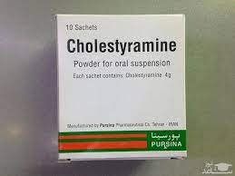
Patient course
In preparation for thyroid radioiodine therapy
She put on cholestyramine and propranolol.

Slide 42
Patient course
For rapid treatment
Cholestyramine 4 g every 12 hours was used to treat hyperthyroidism
The patient had rapid decrease of FT4 by more than 30% only 5 days after cholestyramine was added to the ongoing therapy and normalized by 12 days
prednisolon continued at the same time
The methimazole continueded

Slide 43
Cholestyramine Treatment
Cholestyramine enhances the enterohepatic excretion of thyroxine
Lin et al stated that “complete normalisation of free thyroid hormones and notable symptom improvement have occurred within one week of instituting cholestyramine”
The optimal dosage Can be used twice or four times a day 4 g eatch time for four weeks

Slide 44
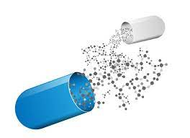
Radioactive iodine
Methimazole stopped 7 days before treatment
Cholestyramine was discontinued
Glucocrticoid &Atenolol continued
We advise 20 mCi RAI
Beta-blocker continued until total T4 and/ or free T4 levels normalize
Nearly took 2 months

Slide 45
Patient course
Surprisingly, the patient's condition improved
prednisolon dose was gradually reduced and discontinued 6 weeks after RAI therapy
Gradually the patient did not need plasmapheresis
At now , after a year since RAI treatment,
There has been no problem

Slide 46
Discussion
A few case reports have described a possible association of Graves disease with TTP.
We present a case in which a patient with Graves disease was found to be biochemically and clinically hyperthyroid with concurrent TTP
TTP usually involves microangiopathic hemolytic anemia, thrombocytopenia, microvascular occlusion
It is associated with other autoimmune diseases,
it is not commonly associated with Graves disease.
It has inherited and acquired forms

Slide 47
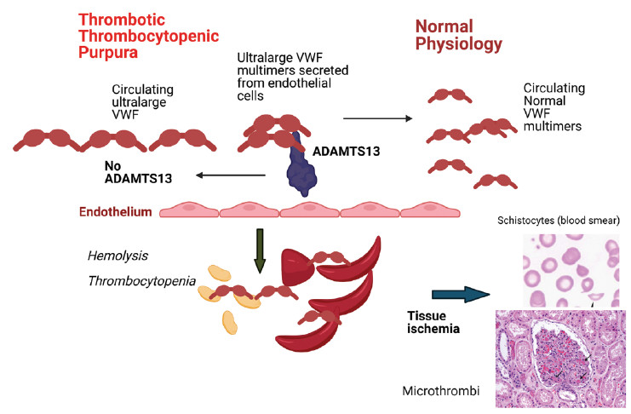
pathogenesis
ADAMTS13 is a metalloproteinase that breaks down vWF; when it is deficient, large multimers of vWF circulate, provoke the formation of thrombi, and
cause widespread platelet activation leading to platelets’ subsequent deficiency and destruction
.

Slide 48
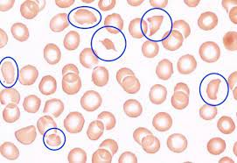
Schistocytes in the peripheral blood smear
.
The identification of schistocytes in the peripheral blood smear associated with the compatible clinical-laboratory scenario is fundamental for the diagnosis of TTP, in addition to being strongly suggestive

Slide 49
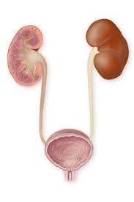
The neurological condition & Renal dysfunction may manifest at any time

Slide 50
Treatment of TTP
Consists of plasmapheresis, favoring enzymatic action by removing pathogenic autoantibodies and cytokines with endothelial action
But the number of sessions continued until normalization of platelet count and LDH level, markers of the therapeutic response
In severe acute or recurrent ,resistant cases
The association of corticosteroids, immunosuppressants and splenectomy may be indicated.

Slide 51
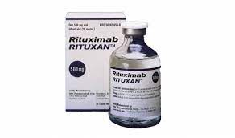
Recently, the monoclonal antibody rituximab has been reported as a therapeutic option for cases of TTP resistant to plasmapheresis

Slide 52
In literature review I found that only a few cases of TTP co-occurring with Graves disease have been described.

Slide 53
Chhabra et al. mentioned one woman who developed sustained remission of TTP after treatment of her hyperthyroidism with radioactive iodine
Probably our patient began experiencing symptoms of TTP a few weeks after stopping methimazole, and her T4 and T3 were elevated on admission, leading us to consider whether her uncontrolled hyperthyroidism could have provoked her TTP

Slide 54
Bellante et al. mentioned that their patient showed improvement in TTP with only radioactive iodine therapy and methylprednisolone.
There was no relapse of TTP in the 6-month follow-up period
The question has been raised before whether treating the hyperthyroid state could concurrently control TTP

Slide 55
Because both Graves disease and TTP are autoimmune diseases,
Lhotta et al. hypothesized that Graves disease triggers some autoimmune processes leading to the production of antibodies to ADAMTS13
Another report illustrated two cases of Graves disease possibly causing a relapse of preexisting TTP; with successful treatment of both TTP and Graves disease, there was rapid and prolonged remission of Graves disease

Slide 56
Key points
If there are any abnormalities in the cell count, especially thrombocytopenia and schistocytes in the peripheral blood smear associated with the compatible clinical-laboratory scenario
Clinicians should consider the possibility of another autoimmune process, such as TTP, in the appropriate clinical context.

Slide 57
Key points
Our patient began experiencing symptoms of TTP a few days after stopping methimazole, and her T4 and T3 were very elevated on admission, leading us to consider whether her uncontrolled hyperthyroidism could have provoked her TTP

Slide 58
Key points
Graves disease triggers some autoimmune processes leading to the production of antibodies to ADAMTS13
And it emphasis that we should be placed on controlling hyperthyroidism and avoiding lapses in medical therapy to prevent complications, as in our patient’s case

Slide 59
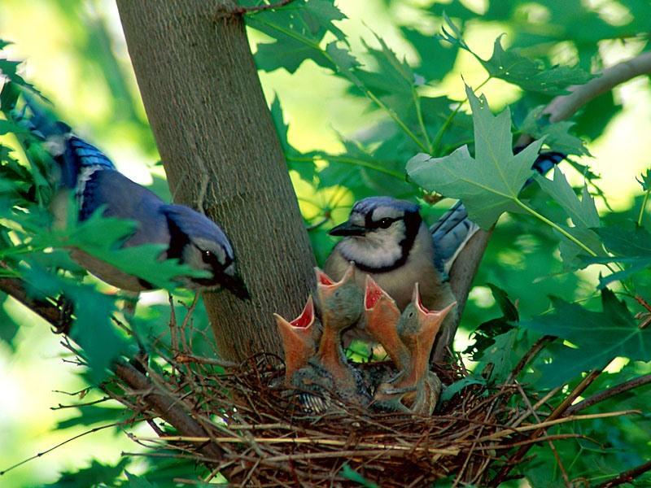
از توجه اساتید و همکاران محترم سپاسگزارم

