Slide 1


Slide 2
M.Hashemipour
Pediatric Endocrinologist
Isfahan University of Medical Sciences
Endocrine &metabolic research center
Child growth &development research center
Long-Term Antithyroid Drug Treatment of
Graves’ Disease in Children and Adolescents

Slide 3
When and How to Treat

Slide 4
How to Choose Treatment?
What are treatment choices?
How to select treatment?

Slide 5
Key Points before Treatment
Discuss with pt logistics, benefits, speed of recovery, drawbacks, potential side effects and cost
Final decision on choice of treatment depends on resources pt preference and physician experience
Absolute neutrophil counts should exceed 1000/mm3 and liver enzyme should be no higher than three times the upper limit of the normal range
Normal gamma-glutamyl transpeptidase
Up to date 2021
Hyperthyroidism in adolescents Endocrine Connections 2021
ATA 2016 Guidelines for Diagnosis and Management of Hyperthyroidism

Slide 6
Key Points before Treatment
Patients should refrain from PE classes and sporting activities until thyroid function normalizes.
After this normalization, no particular restrictions are needed except for participating in vigorous sporting activities.

Slide 7
Management
Graves’ hyperthyroidism is treated by reducing
TH synthesis by using ATD
The destruction of thyroid tissue with RAI or total thyroidectomy

Slide 8
Antihyroid drug therapy
Indication
Patients with high likelihood of remission
individuals in Nursing homes
lack of access to a high-volume thyroid surgeon
Moderate to severe active GO
Need more rapid biochemical disease control

Slide 9
Methimazole
Methimazole is preferred because of
its longer duration of action allowing for once daily dosing
More rapid efficacy
lower incidence of side effects
The half-life in plasma of methimazole is about 6 hours, whereas that of propylthiouracil is about 1.5 hours

Slide 10
PTU
It should be considered for
Patient intolerant to MMI
Early pregnancy
For thyroid storm Blocks T4 → T3 conversion
who refuse 131I therapy or surgery

Slide 11
Why do we start ATD ?
Hyperthyroidism aggravate autoimmunity, leading to the generation of more TRAbs and a worsening of hyperthyroidism.
Once this cycle is broken, by ATD
Rendering the patient euthyroid, may experience gradual remission of the disease

Slide 12
Goal of treatment
To attain a euthyroid state within three to eight weeks Clinical response
This can be followed by continuation of the drug for a prolonged period with the hope of attaining a permanent remission

Slide 13
Methimazole Dose
initial MMI dose be 0.2-0.5 mg/kg
With a range of 0.1-1.0 mg/kg/ day
Endocrine Connections 2021

Slide 14
Methimazole Dose
Patients with
Mild features of hyperthyroidism
Small goiter
Milder elevations of FT4 and T3
0.25 mg/kg/day

Slide 15
Methimazole Dose
Patients with
More severe clinical features of hyperthyroidism
A large goiter
More severe elevations of FT4 and T3
0.5 to 1.0 mg/kg/da
Maximal dose of 30 mg per day for MMI
The use of a larger dose of MMI will only increase the incidence of adverse drug reactions; it will not affect the effectiveness of the therapy.

Slide 16
Methimazole Dose
Children younger than seven years of age typically also require this higher dose
Up to date 2021

Slide 17
Monitoring of children taking MMI
Measure FT4 and T3 every two to six weeks initially.
If these values are elevated, then increase the drug dose approximately 0.25 mg/kg increments
. Repeated test in 4-6 weeks until thyroid function is normal.
ATA 2016 Guidelines for Diagnosis and Management of Hyperthyroidism

Slide 18
Monitoring of children taking MMI
After thyroid function has normalized
Repeat free T4, T3, and TSH at 2-3 month intervals
If a patient is receiving long-term MMI (> 18 months), this interval can be increased to 6 months

Slide 19
Persistent T3 elevation
As some patients normalize their free T4 with MMI
But have persistently elevated serum T3, indicating continuing thyrotoxicosis
Due to intrathyroidal iodine deficiency and the increased T3/T4 ratio in Graves Tg
T3 levels are important to monitor initially
increased intra-thyroidal as well as extra-thyroidal conversion of T 4 to T 3 because of activation of type 1 deiodinase by excess T 4

Slide 20
Persistent T3 elevation
These patients have larger thyroid glands ,high titers of TRAb
Require prolonged treatment with much higher doses of ATD, twice those given to patients with classic

Slide 21
Biochemical response
TSH generally becomes detectable in the serum after two to four months
Patients with persistently low serum TSH after more than six months of therapy are unlikely to have a remission
Consider drug discontinuation

Slide 22
How should the therapy be managed ?
Once T4 and T3 have fallen > 50% and /or normalized, MMI doses can be reduced by 50% or more to maintain a euthyroid state
The maintenance dose for children should be a quarter of the starting dose
while monitoring the FT4& T3 level
Dose is titrated based on free T4& T3
.
Clin Pediatr Endocrinol 2017

Slide 23
How should the therapy be managed ?
When more rapid biochemical control is needed
An initial split dose of MMI may be more effective than a single daily dose because the duration of action of MMI may be less than 24 hours
Continuous treatment, rather than treatment cycles of 2 years, should be considered in future clinical trials.
ATA 2016 Guidelines for Diagnosis and Management of Hyperthyroidism

Slide 24
Is it necessary to prescribe trace element ?
patients should be advised to ingest 1200 to 1500 mg elemental calcium daily through diet or supplements

Slide 25
Is it necessary to prescribe Selenium?
An Antioxidant
Results in GD are not predictable
2 recent RCTs did not show improved control of hyperthyroidism
Low cost & safe
Also used for GO
Evid Based Comlement Altenat Med 2018

Slide 26
What is the role of Selenium?
Glutathione peroxidase which catalyzes the degradation of hydrogen peroxide and lipid hydroperoxide
important in antioxidant defense
increase iodothyronine deiodinase 2
Decrease inflammatory activity in patients with autoimmune thyroiditis
Enhance the efficacy of ATD , improve ocular involvement
increase type I deiodinase activity
selenium deficiency should be considered an independent risk factor for GO

Slide 27
What is the role of Selenium?
it may inhibit cell proliferation and the secretion of proinflammatory cytokines such as tumor necrosis factor alpha ,interferon gammand ,IL-2

Slide 28
Is it necessary to prescribe Stable Iodine?
It is unlikely that long term stable iodine therapy will be adopted in practice
it can be used as a bridge in some cases for longer period than the usual

Slide 29
What patients should be prescribed Stable Iodine?
Patients who have severe hyperthyroidism or are allergic to thionamides
May benefit from alternative medical therapies.
1-2 drops of SSKI daily, can be used to ameliorate very mild hyperthyroidism
SSKI =50 mg iodide /drop

Slide 30
What dose should be prescribed?
For infants or schoolchildren,
10–20 mg /d QD SSKI (12.5 mg/mL)
3–4 drops/d of Lugol’s solution
(1 drop of Lugol’s solution = 6.3 mg iodine).
For junior high school students
1–2 potassium iodide pills (inorganic iodine: 38.2 mg/pill) per day.
T4 secretion decreased as early as 12 hours after administration, reached a plateau effect within 3.–6 days,

Slide 31
What is the mechanism of Cholestyramine?
is an anion exchange resin, binds both T4 and T3 and inhibits enterohepatic circulation.
Rapidly reduce the T3 and T4 when used concurrently
with MMI

Slide 32
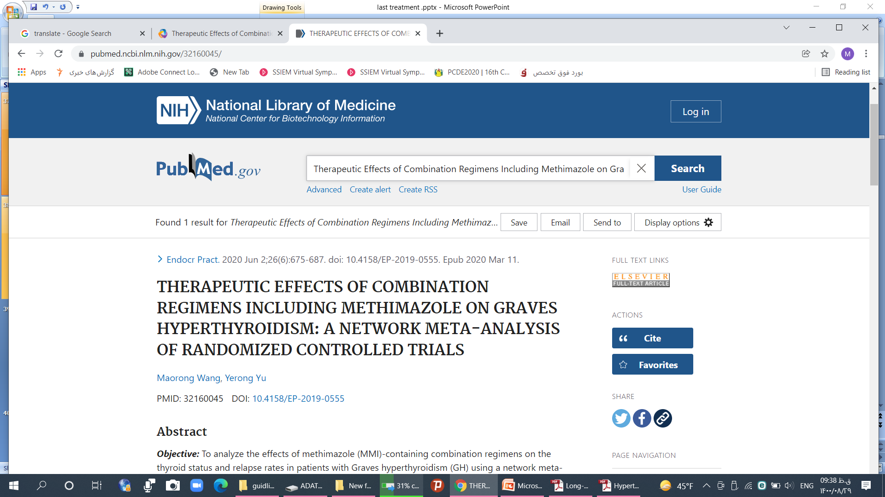
MMI combined with cholestyramine or iodine was shown to regulate serum FT3 and FT4 during the early stage of GD.
MMI combined with immunosuppressants had a long-term advantage in FT3/FT4 regulation and reduced the relapse rate

Slide 33
What is the mechanism of corticosteroid?
suppress T4 secretion from the thyroid
Inhibit conversion of T4 to T3 in peripheral tissues. should be limited to treatment of
Thyroid storm
Graves’ ophthalmopathy
localized pretibial myxedema
pre-thyroidectomy control in patients with severe Graves’ disease

Slide 34
Lifestyle guidance for junior or high-school students
Only for vigorous sporting activities
Excess iodine intake decrease the effects of antithyroid drugs
Smoking reduces the effects of antithyroid drugs, and increases the recurrence rate.

Slide 35
intrathyroidal degradation of ATD was influenced by intrathyroid iodide content
Chronic exposure to excessive iodine resulted in a decrease in ATD uptake in thyrocytes

Slide 36
Beta-Adrenergic Blockade
Propranolol
Atenolol/bisoprolol, β-1 selective , are useful to control adrenergic symptoms such as palpitations and tremor
Metoprolol,nadolol ,Esmolol
High doses of propranolol inhibit peripheral conversion of T4 to T3
propranolol, 0.5–2.0 mg/ kg/d TID
Atenolol, 1–2 mg/kg/d QD
Metoprolol 1.0–2.0 mg/kg/d TID

Slide 37
Beta-Adrenergic Blockade
For symptomatic patients
When free T4 is more than 2–3 times the upper limit of normal
Asymptomatic patients who are at increased risk of complications from worsening of hyperthyroidism
Indicate for Resting heart rates in excess of 100 beats per minute
ATA 2016 Guidelines for Diagnosis and Management of Hyperthyroidism

Slide 38
Calcium channel blockers
Calcium channel blockers can be used in patients who do not tolerate beta adrenergic blocking drugs

Slide 39
Do we need to measure TRAb before to stop ATD?
Measurement of TRAb prior to stopping ATD therapy is suggested because it aids in predicting which patients can be weaned
Patients with persistently high TRAb could continue ATD therapy and repeat after 12–18 months
TRAb level does not decrease during the course of treatment to the same extent as in adults
ATA 2016 Guidelines for Diagnosis and Management of Hyperthyroidism

Slide 40
Correlation between relapse and TRAb
75 percent of patients with undetectable TRAb went into a remission
But 25 percent relapsed.
Thus, thyroid function tests should be rechecked four to six weeks later
Then every three to four months for the next year
UP TO Date 2021

Slide 41
Criteria for Antithyroid Drug Discontinuation
The discontinuation of ATD therapy can be considered if the result of 2 consecutive measurements of TRAb, performed in an interval of 6 months, is within the reference value (negative result)
Endocrine Connections 2021
.

Slide 42
Criteria for Antithyroid Drug Discontinuation
If the goiter decreases in size and negative TRAb results are maintained, the patient may have achieved remission
Clin Pediatr Endocrinol 2017

Slide 43
Criteria for Antithyroid Drug Discontinuation
if normal thyroid function is maintained with the maintenance dose of an antithyroid drug approximately 5 mg of MMI/every other day to 5 mg/d for more than 6 mo
Consider discontinuation of the drug.
Clin Pediatr Endocrinol 2017
UP TO Date 2021

Slide 44
Criteria for Antithyroid Drug Discontinuation
Dose titration method
Discontinued when
Euthyroidism was maintained at the lowest dose
2.5 mg/day for 6-12 months.
ORIGINAL RESEARCH 2021
Up to date 2021

Slide 45
Criteria for Antithyroid Drug Discontinuation
Drug withdrawal is usually carried out during school vacation as to minimize potential interference with performance.

Slide 46
How long ATDs should be used in children ?
long-term treatment for up to 10 years
we prescribe MMI indefinitely till
leaving home for college
Until the child is considered old enough for surgery or RAI ( 16 years or older)
ATA Guidelines 2016
Clin Pediatr Endocrinol 2017
UP TO Date 2021

Slide 47
How long ATDs should be used in children ?
A report from France shows that with prolonged ATD use, remission rates of up to 49% 10 years follow-up of 154 children treated with ATDs
ATA 2016 Guidelines for Diagnosis and Management of Hyperthyroidism

Slide 48
Adverse Events
Patients should be given written instructions regarding the symptoms of possible agranulocytosis (sore throat, fever, mouth ulcers)
Need to stop treatment pending a complete blood count.
Patients should be informed of potential side
effects of ATD if they should develop

Slide 49
Adverse Effects ofMMI
Dose-dependent >30mg/day
Agranulocytosis < 500 granulocytes / mm³ )in 0.3%;
watch fever sore throat; usually first 3 mos
Hepatotoxicity – watch liver enzymes
Vasculitis – arthralgia, positive markers
vasculitis can happen later

Slide 50
Adverse Effects ofMMI
Monitor adverse drug reactions every 2–3 wk for at least 2–3 mo
Dose-related and occur within the first 3 months of treatment
High doses of MMI >30 mg
ATA 2016 Guidelines for Diagnosis and Management of Hyperthyroidism
Clin Pediatr Endocrinol 2017

Slide 51
Adverse Effects ofMMI
MMI associated with
Cholestatic pruritic, jaundice, acolic stools ,dark urine
Rash, or, arthralgias
Abdominal pain, nausea
Fatigue
Fever
pharyngitis
Abnormal taste sensation
UP TO Date 2021

Slide 52
Adverse Effects ofMMI
switching from one ATD to the other is safe in the case of minor side effects,
In patients with minor skin reactions, an antihistamine can be added
ATA 2016 Guidelines for Diagnosis and Management of Hyperthyroidism

Slide 53
Minor side-effects of MMI
Persistent symptomatic minor side effects include
pruritus, arthralgia, gastrointestinal distress.
Abnormal sense of taste,sialadenitis
we discontinue the drug for a few days until the symptom subsides if repeat
changing to RAI or surgery, or switching to the other ATD when RAI or surgery are not options.

Slide 54
Management of serious allergic reactions in children taking MMI
Antihistamine
Cessation of the medication
Changing to therapy with RAI or surgery
ATA 2016 Guidelines for Diagnosis and Management of Hyperthyroidism

Slide 55
Major side-effectsof MMI
Far less frequently ANCA-positive vasculitis beyond 1 yr of treatment
Polyarthritis
purpuric skin lesions
Occasionally pulmonary involvement
and/or renal involvement
Enlargement of lymph nodes
Toxic psychoses
The risk appears to increase with duration of therapy
TA 2016 Guidelines for Diagnosis and Management of Hyperthyroidism
Clin Pediatr Endocrinol 2017

Slide 56
ANCA positive
While up to 40% of patients taking PTU&
16% of patients on MMI
Develop ANCA positivity
Vast majority of such individuals do not develop clinical vascutitis
When the drug is discontinued, the ANCA slowly disappear in most individuals .
15 percent of ANCA-positive patients develop clinical evidence of vasculitis

Slide 57
ANCA positive
Children seem to be more likely to develop PTU-related ANCA positive vasculitis
In most cases, the vasculitis resolves with drug discontinuation, although immunosuppressive therapy may be necessary
Patients who use PTU for extended periods of time should undergo an annual serum MPO-ANCA measurement
Urinalysis should be performed for those with positive results

Slide 58
ANCA positive
If the antibody level is low and the patient is asymptomatic, it should be explained that the MPO-ANCA test was positive and the patient is at risk of developing MPO-ANCA-associated vasculitis syndrome.
After obtaining consent, PTU use can then be continued.

Slide 59
Lupus-like syndrome
The third and rarest major side effect
Is more common with PTU and appears to occur more frequently in Asians.
Clinical features include
fever, arthritis, hematuria, proteinuria, ARF, vasculitic rashes, skin ulcerations and hemorrhage. Stevens–Johnson syndrome

Slide 60
Treatment of Lupus like syndrome
Discontinuation of ATD
Glucocorticoids
Cyclophosphamide
Hemodialysis in more severe cases
inorganic iodine

Slide 61
insulin autoimmune syndrome
Rare cases of with symptomatic hypoglycemia have been reported in patients treated with MMI

Slide 62
Consensus about periodic monitoring
No consensus exists concerning the utility of periodic monitoring of WBC counts and liver function tests in predicting early onset of adverse reaction to the medication
Hyperthyroidism can itself cause mildly abnormal liver function tests in up to 30% of patients
ATA 2016 Guidelines for Diagnosis and Management of Hyperthyroidism

Slide 63
When to measure WBC?
ATDs should be stopped immediately and WBC counts measured in children who develop
Fever
Jaundice
Light-colored stools
Dark urine
Arthralgias
Mouth sores
pharyngitis
Malaise
Gingival sores.
Chills
cystitis
Diarrhea
2018 European Thyroid Association

Slide 64
When to Hold the MMI?
If the granulocyte count is low<1500/mm³
Hold the MMI
Monitoring the WBC twice weekly
These counts usually recover spontaneously within one to two weeks
Once the granulocyte count is >1500/mm³
we restart MMI
Rarely (G-CSF) should be administrated

Slide 65
When to Hold the MMI?
ATD should be immediately discontinued if the granulocyte count is less than 1000 cells/mm3
Administration of broad-spectrum antibiotics and granulocyte colony-stimulating factor , which has been shown to reduce the recovery time.

Slide 66
Agranulocytosis
Granulocytosis<500/mm³ is a contraindication to ATD treatment
To occur abruptly within2- 3 months after the initiation of ATD therapy .(PTU)
is the most frequent major side-effect
Certain HLA-B and HLA-DR polymorphisms linked to higher risk of ATD-associated agranulocytosis

Slide 67
Is the rise in alkaline phosphatase the cause of worsening the disease?
with improving thyrotoxicosis, a rising alkaline phosphatase with normalization of other liver function does not indicate worsening hepatic toxicity because the origin of the alkaline phosphatase is from bone, not liver

Slide 68
Hepatotoxicity
The ATA/AACE guidelines recommend:
Obtaining a serum liver profile at baseline
But not recommend periodic monitoring

Slide 69
When to stop PTU?
PTU should be stopped immediately and LFT assessed in children who experience
Anorexia, pruritus, rash, jaundice,
Light colored stool or dark urine, fatigue
joint pain, right upper quadrant pain
Abdominal bloating, nausea, or malaise

Slide 70
PTU & Hepatic failure
There is a higher prevalence of adverse reactions to ATD in children and this means that PTU is no recommended owing to hepatic failure (up to 1 in 2,000).
If children develop adverse reactions while taking ATD, early surgery with total thyroidectomy is generally recommended

Slide 71
Hepatotoxicity
liver function and hepatocellular integrity should be assessed in patients taking propylthiouracil
It usually develops within 3 months of therapy
incidence peaks in the first 30 days of treatment

Slide 72
liver injury with ATD
Because PTU and MMI may cross-react, adverse reactionsmay occur even with a change in the drug regimen
FDA issued a black box warning regarding the use of PTU
PTU-induced liver injury is of rapid onset and can be rapidly progressive
Clin Pediatr Endocrinol 2017
ATA 2016 Guidelines for Diagnosis and Management of Hyperthyroidism

Slide 73
Hepatotoxicity of PTU
Occurs foremost in children in contrast to that associated with MMI, which is usually milder with a cholestatic pattern
ATD are stopped and not restarted if
patient develops major side effects.
Transaminase >3 times discontinuing the drug

Slide 74
Relapse
Relapse is most likely within the first 6–12 months after ATD withdrawal, but may occur years later. Outcome is difficult to predict
Relapse rate in children varied from 3 to 47 percent in different series
only 10% of patients relapsing after 18 months.
Relapse rate in adult 75 percent after 3 month

Slide 75
Relapse
These Patients are most likely to relapse when treatment stops
More consistent factors
large goiters (>2.5 normal)
persistent high serum of TSH-R-Ab
Free T4 (>4 ng/dl), High total T3
HLA subtypes DQB1*02, DQA1*05, and DRB1
Severe degree of thyrotoxicosis
Lack of decrese thyroid size during treatment
Lack of normalization of TSH
Age <12 years

Slide 76
Relapse
Depends on
TRAb levels at onset and at the end of treatment
Duration of medical treatment
Low Body mass index

Slide 77
Relapse
Shortly after GD diagnosis
TRAb > 6 IU/l at diagnosis
Anti-TPO > 5000 IU/ml
TRAb level > 7.5 IU/l at the end of 12-month ATD therapy
> 3.85 IU/l at the end of 18-month ATD
Predicted relapse with a specificity of 96–97 %
Up to date 2021

Slide 78
Relapse
inconsistent factors
Lower age
Smoking
Male sex
Duration of symptoms before diagnosis
Orbitopathy
Psychiatric disorders

Slide 79
Treatment of relaps
Children who relapse can be treated with any of the same three treatment modalities
UP TO Date 2021

Slide 80
Definition of remission
Remission defined as being euthyroid for 1 year after cessation of therapy
patients who remain euthyroid for at least six months after discontinuation of antithyroid drug therapy 25 to 65 percent in different series
ATA 2016 Guidelines for Diagnosis and Management of Hyperthyroidism
Clin Pediatr Endocrinol 2017
UP TO Date 2021

Slide 81
Predictors of Remission
Higher body mass index
TRAb low or negative
Small goiter
Nonsmoker
Mild disease
Patients older than 13 yr of age
Lower initial T4 < 20 µg/dl; T3 : T4 ratio < 20

Slide 82
Predictors of Remission
prepubertal children may take longer to enter remission than pubertal children
Euthyroid status after three months of ATD
Aged <5 y old
No family history of thyroid disease
low FT4 level at diagnosis <7ng/dl
Up to date 2021

Slide 83
Criteria for full remission
No goiter
Clinical euthyroidism
TSH, fT4 and fT3 within normal ranges
Negative results of TRAb
Normoechogenic thyroid gland on ultrasound without increased blood flow.
Up to date 2021
.

Slide 84
Comparison between children &adult for Remission rates
It is clear that children treated with antithyroid drugs take longer to enter a permanent remission than adults

Slide 85
longer-term treatment &remission rates
Some studies report that the remission rate increases by 25% for every additional 2 years of ATD treatmen
longer duration of minimum dose treatment is associated with a higher remission rate
Clin Pediatr Endocrinol 2017
UP TO Date 2021

Slide 86
Follow up of patients who are in remission
Patients who enter remission need lifelong monitoring after antithyroid drugs are stopped
Thyroid function testing should be monitored
Every 2- to 3-month intervals for the first 6 months
Then every 4- to 6-month for the next 6 months
Then every 6–12 month
Then annually

Slide 87
Management of patients who do not enter remission
Approximately one-half of children will achieve a remission if treated long term with MMI
For this reason, we do not recommend a trial off of MMI after an arbitrary period of treatment
we prescribe MMI indefinitely (when leaving home for college )
At this point, most select RAI treatment, while some choose surgery.
Up to date 2021

Slide 88
Surgery
Total thyroidectomy is choice, because the rate of recurrent is lower
Hyperthyroidism should be adequately controlled (Euthyroid) by ATD prior to surgery. to avoid peri- or postoperative exacerbation of thyrotoxicosis.

Slide 89
Surgery
Indiction
Coincident primary hyperparathyroidism
Suspicion of malignant nodules
Large thyroid nodules especially if greater than 4 cm or if nonfunctioning, or hypofunctioning
patients with moderate to severe active GO
Cannot use ATD
Thyroid-related compressive symptoms
ATA 2016 Guidelines for Diagnosis and Management of Hyperthyroidism

Slide 90
Surgery
Indication
individuals < 5 years of age
large thyroid glands ( > 80 g)
To achieve remission sooner
Facilities for RAI treatment are not available
patient wishes to avoid exposure to ATD or RAI
Refractory to several applications of RAI
women planning pregnancy within the following 6 months
J Pediatr Endocrinol Metab 2016
Clin Pediatr Endocrinol 2017

Slide 91
What medications are needed before surgery?
ATD
Beta-blockers
Glucocorticoids
Vitamin D deficiency should be corrected prior to surgery to reduce the risk of postoperative hypocalcemia

Slide 92
What medications are needed before surgery?
The use of SSKI is helpful in the immediate preoperative period (10 days) to decrease thyroid vascularity and intraoperative blood loss
Decrease in height of the follicular cells
Enlargement of follicles with retention of colloid
Reduction of hypervascularity
induce involution of the gland

Slide 93
potassium iodide
Lugol solution
8 mg/drop
20 drops per mL
1 drop by mouth three times daily
Potassium iodide (SSKI)
35 to 50 mg/drop
1 to 2 drops bid by mouth daily
SSKI can be mixed in juice or milk

Slide 94
What precautions to take about iodine?
Surgery should be set until a normal metabolic state
Therapy with iodide should not be started until a normal metabolic state because iodide will enrich glandular hormone stores if the antithyroid drug is not entirely effective
Antithyroid agents should not be withdrawn when iodine therapy is begun.

Slide 95
Urgent surgery
In exceptional condition when it is not possible patient to be euthyroid prior to thyroidectomy, the need for thyroidectomy is urgent
patient should be adequately treated with
Beta-blockade
potassium iodide
Glucocorticoids
potentially cholestyramine
in the immediate preoperative period

Slide 96
What are important issues before surgery ?
Thyroid cancer occurs in GD with a frequency of 2% or less .
Thyroid nodules larger than 1–1.5 cm should be evaluated.
If a radioactive iodine scan is performed, any nonfunctioning or hypo-functioning nodules should be considered for FNA as these may have a higher probability of being malignant

Slide 97
The use of thyroid ultrasonography in all patients with GD has been shown to identify more nodules and cancer than does palpation.

Slide 98
What are important issues before surgery ?
If the cytopathology is suspicious or diagnostic of malignancy
Surgery is advised after normalization of thyroid function with ATDs.
Surgery should also be considered for indeterminate cytology.

Slide 99
Preoperative assessment of calcium and vitamin D

Slide 100
What are important issues before surgery ?
if calcitriol is started 3 days before surgery ,the need
for postoperative calcium infusions is markedly reduced,
Then weaned over the first two postoperative week

Slide 101
Post surgical hypocalcaemia
Transient hypocalcemia normally resolves within 6 months after thyroidectomy
Hypocalcemia to be permanent if recovery has not occurred within 6 months
Eur Thyroid J 2021

Slide 102
Near-total thyroidectomy
is not a perfect decision since thyroid tissue remnants can still be immunogenic in TRAb production, maintaining the risk for relapse and TED and nodule formation
Endocrine Abstracts 2020

Slide 103
Contraindication of surgery
High free T4 estimates >5 ng/dL
High TSH receptor antibody levels
J Med Assoc Thai 2016

Slide 104
Long term survival
Disease-free survival at 20 years is reported to be 99% after thyroidectomy for GD in patients with small (≤1 cm) coexisting thyroid cancers

Slide 105
Following thyroidectomy
L-thyroxine should be started at a daily dose appropriate for the patient’s weight
Serum TSH measured 6–8 weeks postoperatively
If TSH was suppressed preoperatively, a free T4 and TSH should be measured 6-8 weeks postoperatively, since recovery of the pituitary-thyroid axis is occasionally delayed
levothyroxine is started 1.6 mcg/kg/day and thyroid levels should be checked 6-8 weeks

Slide 106
Following thyroidectomy
Monitoring PTH levels in the immediate postoperative phase has the ability predict symptomatic hypocalcemia if PTH value is low
But normal PTH levels are not able to guarantee normocalcemia thus suggesting that vitamin-D insufficiency is likely to be present in these cases.
Treatment for hypocalcemia should start with oral calcium

Slide 107
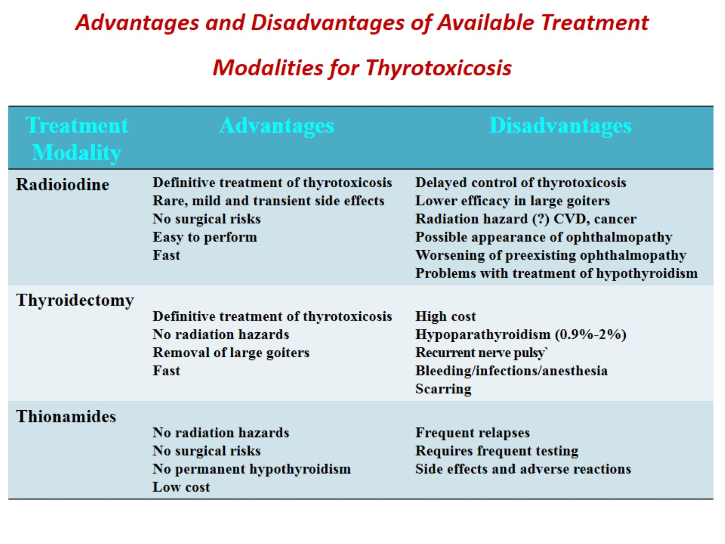
Advantages and Disadvantages of Available Treatment Modalities for Thyrotoxicosis

Slide 108
The comparisn between three modalities
 | Advantage | Hypothyroidism | Disadvantage | Cost
ATD | Nonablative | Low | Recurrence side effects | +
RAI | Definitive | 100% | Fear | ++
Surgery | Definitive | 100% | Complications | +++

Slide 109
Outcome of Graves disease
An increase in gastric and respiratory tract cancers to the hyperthyroidism
Hyperthyroid women was associated with a slightly
increased breast cancer attributed to increased cellular
proliferation from hyperthyroidism

Slide 110
Immune Reconstitution
GD was seen in multiple sclerosis patients who had received lymphocyte-depleting alemtuzumab
12–24 months later 20–30% of patients developed TSH-R-Ab-positive GD
patients with HIV who have received effective highly active antiretroviral therapy, developed hyperthyroidism
ATD should be continue until TSH-R-Ab become undetectable.
painless thyroiditis, transient hyperthyroidism and hypothyroidism

Slide 111
Immune Reconstitution
GD has also been observed in bone marrow transplant patients
They can be managed similarly to patients with “spontaneous” GD
Thyroid peroxidase and thyroglobulin antibodies were present in 45% and 33% at the time of diagnosis

Slide 112
Immune Reconstitution
Increased risk of hyperthyroidism after radiation therapy during childhood which was positively associated with external radiation dose to the thyroid gland

Slide 113
References
American Thyroid Association Guidelines for Diagnosis and Management of Hyperthyroidism and Other Causes of Thyrotoxicosis 2016
JAMAPediatrics 2017
Horm Res Paediatr 2017
Clin Pediatr Endocrinol 2017
Ata 2018
Up to date 2021

Slide 114
References
European Thyroid Association 2018
Guideline for the Management of Graves’ Hyperthyroidism Eur Thyroid J 2018
Best Practice & Research Clinical Endocrinology & MetabolismJ Clin Res Pediatr Endocrinol 2013
Curr Opin Endocrinol Diabetes Obes 2019
JAMA Pediatr. 2016
Clin Pediatr Endocrinol 2017

Slide 115


