Slide 1
New treatment for achondroplasia
Dr. Parastoo. Rostami
Associate of professor of pediatric endocrinologist
Tehran university
Children’s medical center

Slide 2
Epidemiology
Achondroplasia is the most common form of human dwarfism.
an estimated birth incidence of 1 in 10 000 to 1 in 30 000
There is no recognized ethnic or sex predisposition.
Skeletal dysplasia represents 5% of all birth defects and comprises 461 different diseases

Slide 3
Pathophysiology
The molecular basis of achondroplasia was elucidated in 1994 with the identification of the fibroblast growth factor receptor 3 (FGFR3) as the causative gene.
All instances of achondroplasia arise from mutations that are autosomal dominant. an individual affected with achondroplasia (and whose partner is of average stature) has a 50% risk for each of their offspring to be similarly affected.
However, most instances of achondroplasia – perhaps 80% – arise from new, spontaneous mutations. The risk of a new mutation increases with the age of the father

Slide 4
FGFR3 is a member of the receptor tyrosine kinase family (RTK).
This protein contributes to the production of collagen and other structural components in tissues and bones.
When the FGFR3 gene is mutated it interferes with how this protein interacts with growth factors leading to complications with bone production, Cartilage is not able to fully develop into bone, causing the individual to be disproportionately shorter in height
Missense mutations causing achondroplasia result in activation of FGFR3 and its downstream signaling pathways, disturbing chondrogenesis, osteogenesis, and long bone elongation

Slide 5
Clinical Manifestations
The spectrum of chondrodysplasia phenotypes associated with FGFR3 missense mutations range from mild to severe.
Hypochondroplasia, the mildest form of FGFR3-related dwarfism, is caused by mutations localized in the tyrosine kinase domain I of the protein
SADDAN syndrome (Severe Achondroplasia with Developmental Delay and Acanthosis nigricans) by a specific mutation (K650M) localized in the tyrosine kinase domain II of FGFR3
thanatophoric dysplasia, an almost uniformly lethal skeletal dysplasia, by mutations localized primarily in the extracellular domain of FGFR3

Slide 6
Presentation
Neonate:
The vast majority of individuals with achondroplasia are diagnosed in early infancy
prenatal recognition has become more frequent and more accurate
It is critical that diagnosis not be delayed since certain complications can only be prevented through assessment in early infancy
No formal clinical diagnostic criteria have been published, but well defined clinical and radiologic characteristics of achondroplasia usually allow for virtual certainty

Slide 7
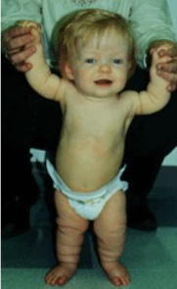
Small stature
Small size is not a constant feature in infants, who may have lengths within the normal range
Short limbs and rhizomelic disproportion. Rhizomelic (proximal) shortening is uniformly present (at least in the arms, although variable in severity.
Often there are redundant skin folds of the upper arms and the thighs

Slide 8
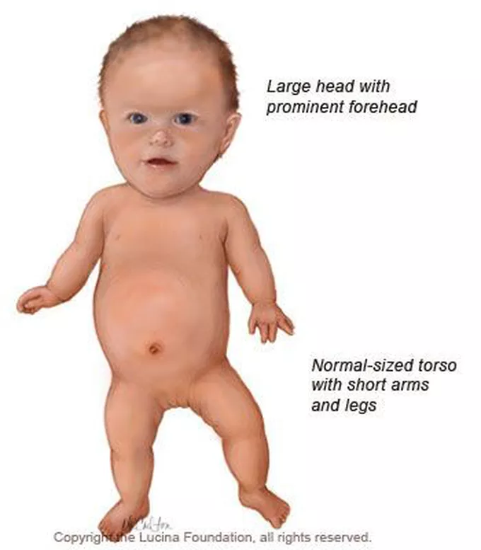
Macrocephaly
Head size is usually large at birth and remains so throughout life
Variable frontal and parietal bossing (prominence and bumpy protuberance) is usually present
The anterior fontanel is often large in infancy and may persist to as late as 5 or 6 years of age.

Slide 9

Midfacial retrusion
Underdevelopment of cartilaginous bones of the face result in flattening of the entire midface and a flat nasal bridge, a short nasal spine and anteversion of the nose

Slide 10
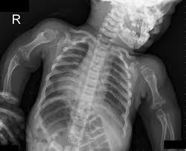
Small chest
In addition to the chest being often smaller than average, the ribs are overly compliant.
This results in paradoxical movement with inspiration, which is often misinterpreted as being retractions reflecting respiratory distress.

Slide 11
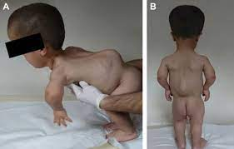
Thoracolumbar kyphosis
Virtually all infants develop a dynamic thoracolumbar kyphosis in infancy, but this is not present at birth.
Lumbar hyperlordosis.
Exaggerated lordosis (“swayback”) arises when walking begins.

Slide 12
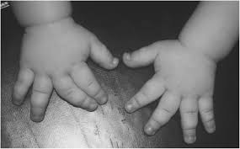
Limited elbow extension
Unlike most other joints, the elbows are stiff and may, with age, become progressively stiffer.
Short fingers and trident configuration of the hands

Slide 13
Hypermobile hips and knees.
Hypotonia
The combination of joint hypermobility and hypotonia means that many infants will seem particularly “floppy”.

Slide 14
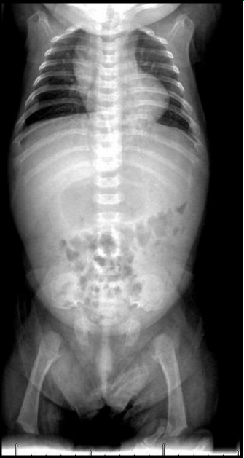
Radiological findings
The iliac wings are round, there is lack of caudal widening of the interpedicular distances, the femurs are short, and the proximal ends (metaphyses) have a scooped appearance.

Slide 15
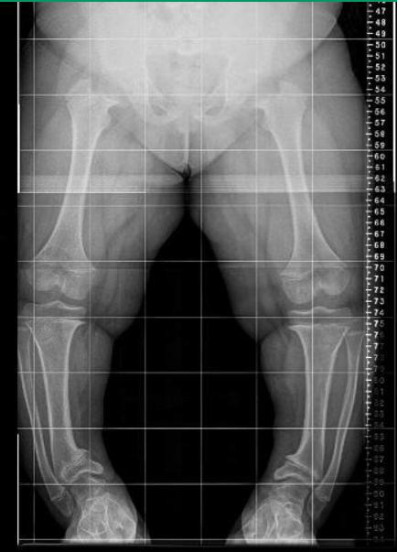
Femus and tibiae are short. There is fibular overgrowth and marked bowing of the tibial-fibular region.

Slide 16
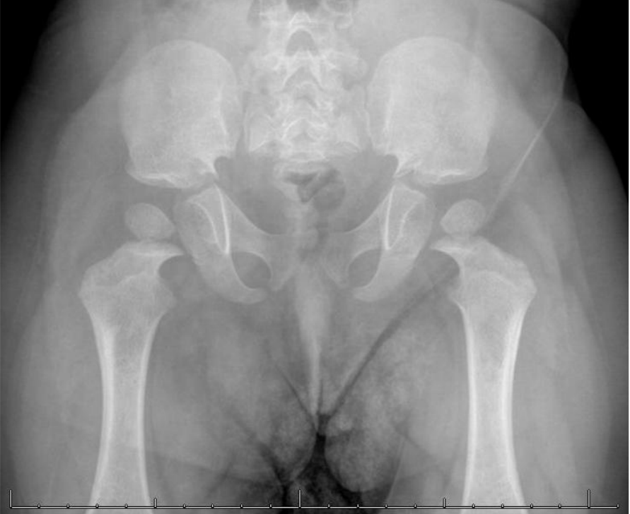
Abnormal proximal scooping of the femurs. Small round pelvis and small sacrosciatic notches.

Slide 17
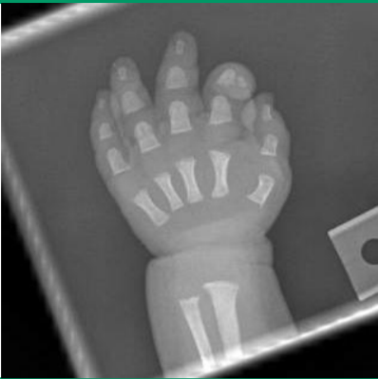
There is generalized shortening of metacarpals and all phalanges.
The spaces between the second and fourth digits with the middle finger suggest the presence of the trident deformit

Slide 18
Management

Slide 19
The management and the treatment of ACH are major challenges of many centers involved in rare skeletal disorders
One therapy offered to ACH patients is treatment with recombinant human growth (r-hGH) (approved today only in Japan)
No clear long term benefit has been established with this treatment, which does not address the underlying pathogenetic mechanisms
Surgical limb lengthening is also a therapy employed for achondroplasia
The use of intramedullary nails might improve outcomes and is now recommended as the implant of choice of femoral lengthening

Slide 20
Novel treatment
Soluble FGFR3 as a decoy receptor (TA-46/recifercept): Soluble receptors exert their biological effects through mechanisms of action that are defined by their relationship to ligands and membrane-bound receptors. phase I studies employing this molecule (recifercept; Pfizer Ltd).
Anti-FGFR3 antibody (B-701/vofatamab): Monoclonal antibody therapy is also used routinely in oncology. In the future, FGFR3-specific monoclonal antibodies will potentially be an additional therapeutic option for ACH patients.
Tyrosine kinase inhibitor (BGJ398/infigratinib): phase 1 clinical trial
Meclozine, an anti-histamine and motion sickness drug was considered as putative treatment, as it was demonstrated that meclozine downregulated the phosphorylation of ERK, a downstream FGFR3 pathway

Slide 21
Vosoritide (Voxzogo)
a modified C-type natriuretic peptide, directly targets the underlying pathophysiology of achondroplasia by down regulating fibroblast growth factor receptor 3 (FGFR3) signaling and consequently promoting endochondral bone formation.

Slide 22
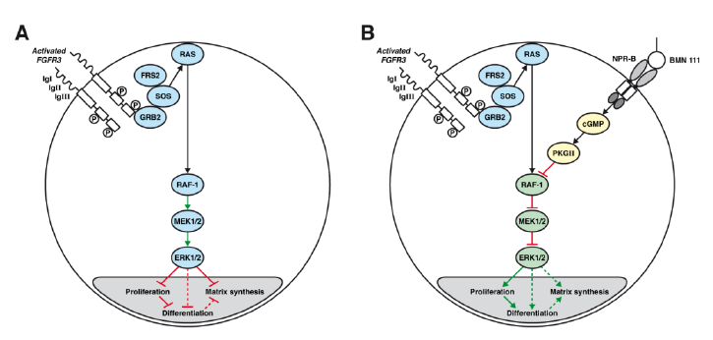

Slide 23
VOXZOGO is a prescription medicine used to increase linear growth in children with achondroplasia who are 5 years of age and older with open growth plates (epiphyses).
VOXZOGO is taken daily as an injection given under the skin, administered by a caregiver after a healthcare provider determines the caregiver is able to administer VOXZOGO.
Voxzogo 0.4 mg powder + 0.5 mL of solution: concentration of 0.8 mg/mL
Voxzogo 0.56 mg powder + 0.7 mL of solution: concentration of 0.8 mg/mL
Voxzogo 1.2 mg powder + 0.6 mL of solution: concentration of 2 mg/mL
This medicinal product contains less than 1 mmol sodium (23 mg) per unit volume, that is to say essentially ‘sodium-free’.
The usual dose is 15 µg/kg body weight

Slide 24
Patients should be well hydrated at the time of injection. It is recommended patients eat a light snack and drink a glass of fluid (e.g., water, milk, juice, etc.) about 30 minutes before injecting.

Slide 26
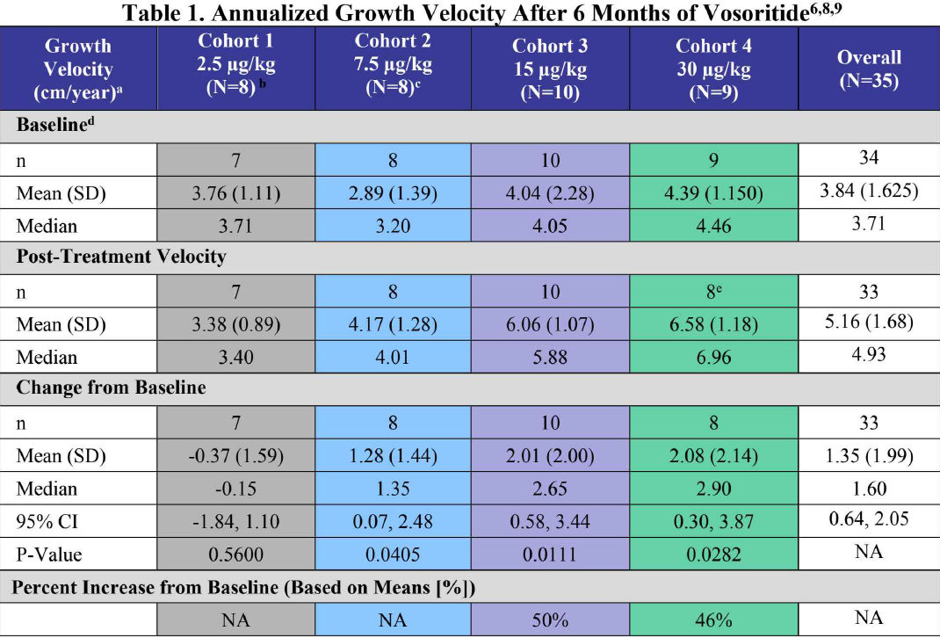

Slide 27
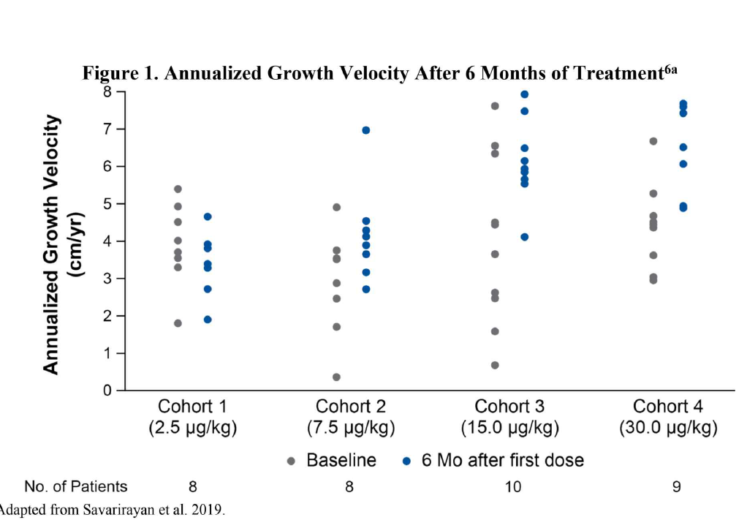

Slide 28
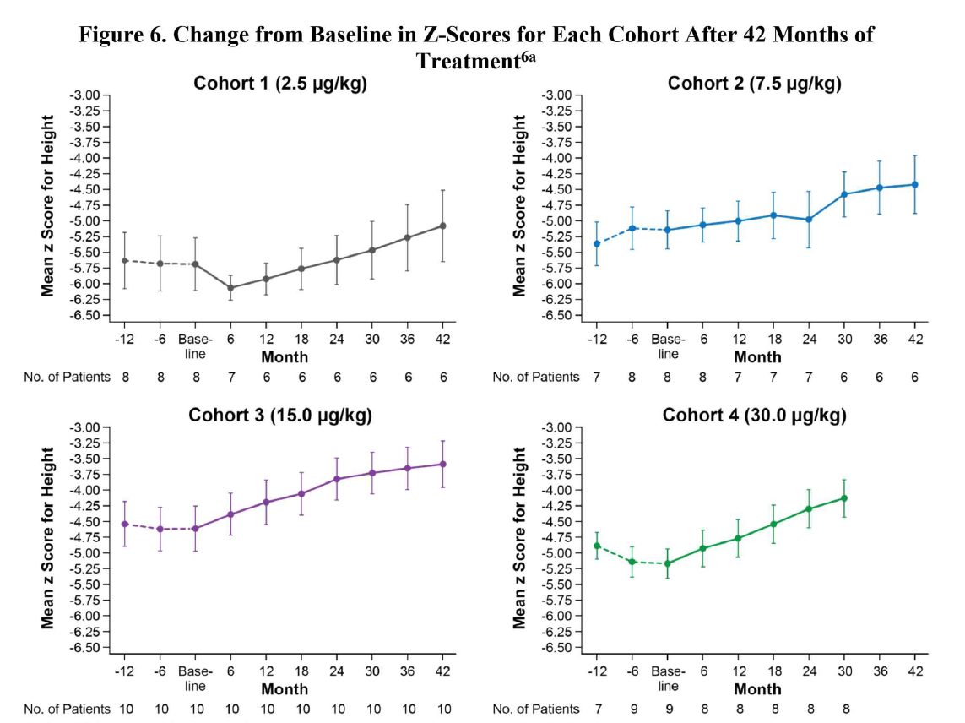

Slide 29
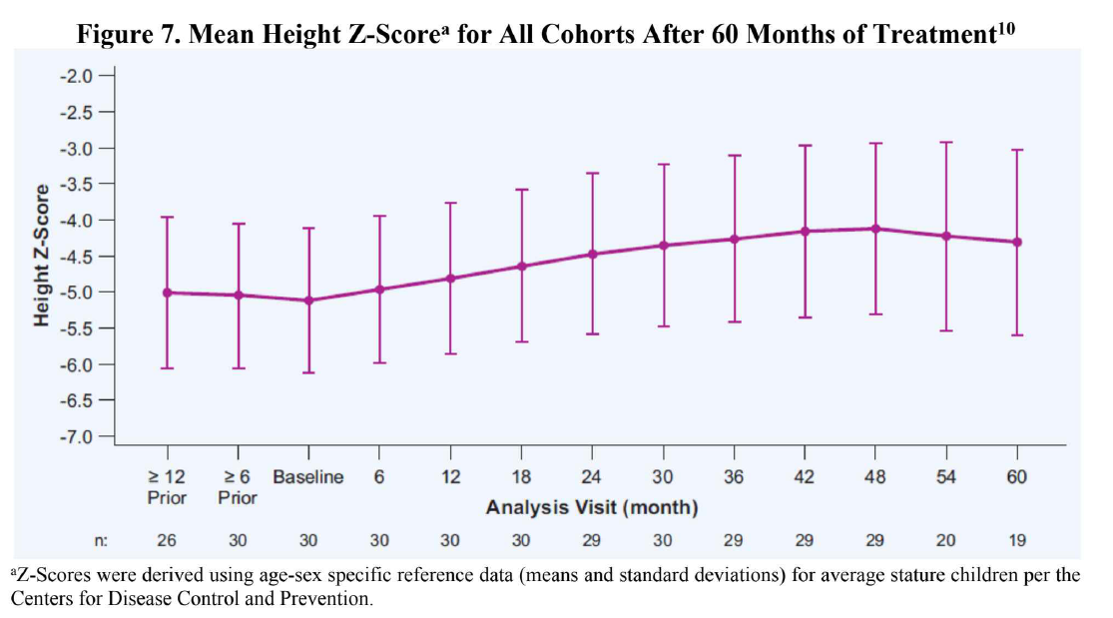

Slide 30
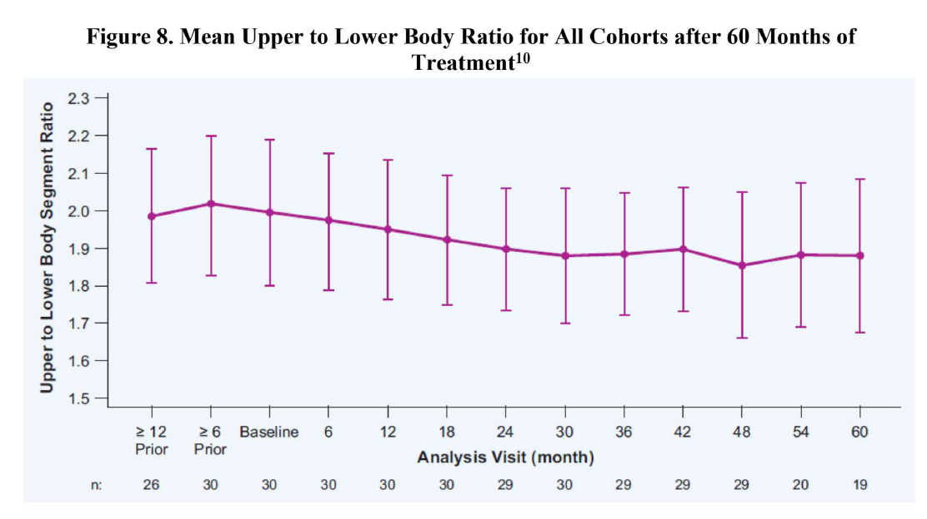

Slide 31
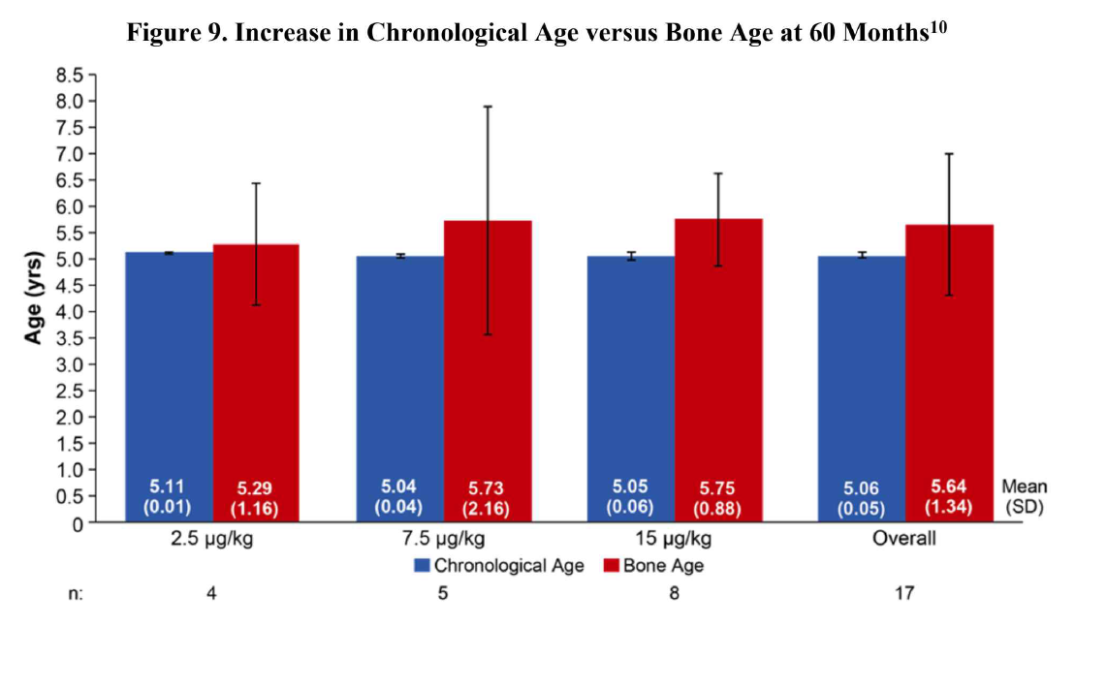

Slide 32
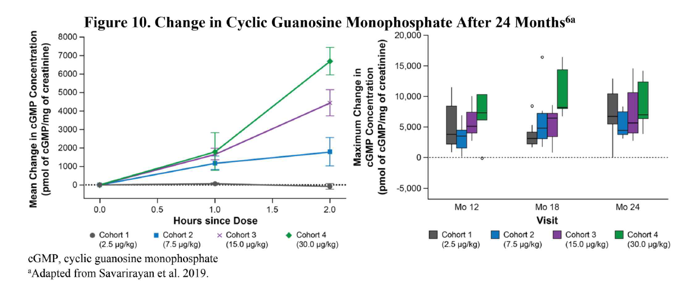

Slide 34
Duration of treatment Treatment with this medicinal product should be stopped upon confirmation of no further growth potential, indicated by a growth velocity of < 1.5 cm/year and closure of epiphyses.
Growth monitoring Patients should be monitored and assessed regularly every 3-6 months to check body weight, growth and physical development. Dose should be adjusted according to the patient’s body weight
vosoritide is unlikely to cause CYP- or transporter-mediated drug-drug interactions in humans when the medicinal product is administered concomitantly with other medicinal products.

Slide 35
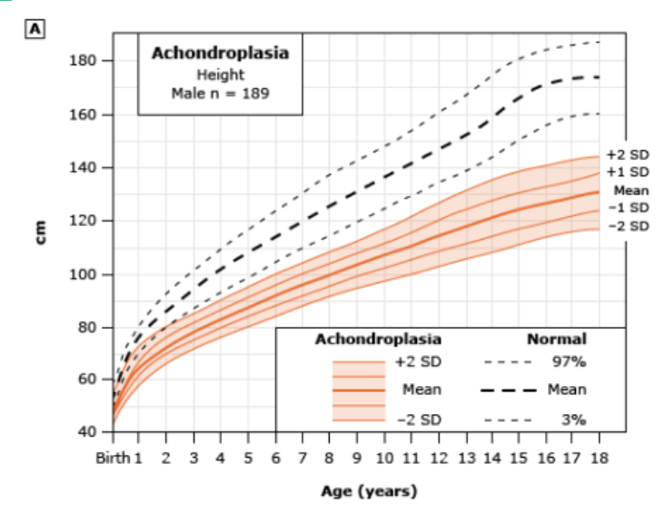

Slide 36


