Slide 1
Case report
Dr.majid vares vazirian
Ped endocrinologist

Slide 2
Case Presentation
The 8-year-old girl referred to endocrine clinic about one year ago with
enlargement of anterior of neck space and feeling of swelling since one month
prior to visit. After initial workup and evaluation on her laboratory tests:
Thyroid-stimulating hormone (TSH) : 55 mIU/L
Anti TPO : 302 IU/mL.
Thyroid sonography : mild goiter
Medical treatment with tablet of Euthrox 50 mcg daily started with diagnosed of Hashimoto
thyroiditis.

Slide 3


Slide 4
Lab Test
She was well and her symptoms was controlled for about 1 year but since one month ago due to lack of accessibility to drug she did not use that tablet and came to clinic with low energy level, tiredness and sleepiness, mild to moderate enlargement of neck and alopecia.
The rest of her physical examination was within normal.
Investigations : normal urea and electrolytes, normal hemoglobin and platelet count and white blood cell count.
Thyroid-stimulating hormone (TSH) : 33 mIU/l (normal range 0.1–5.0)
Free T4 : 0.5 ng/dL (normal range 0.7 to 1.5 ng/dL).

Slide 5
She was started on L-thyroxine therapy with another trade name (Levoxine 50
mcg) daily but on follow up 2 days later, she developed significant color changes and progressive purplish discoloration of the tips of all hand fingers.
Peripheries were cool on examination but she described no pain and these
symptoms revealed a Raynaud phenomenon in this patient.

Slide 6
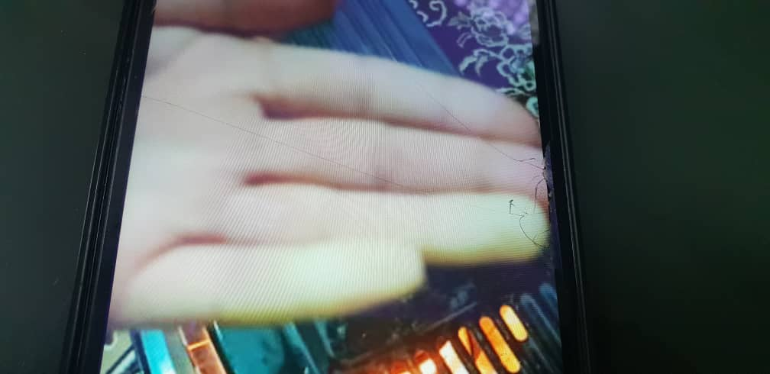

Slide 7
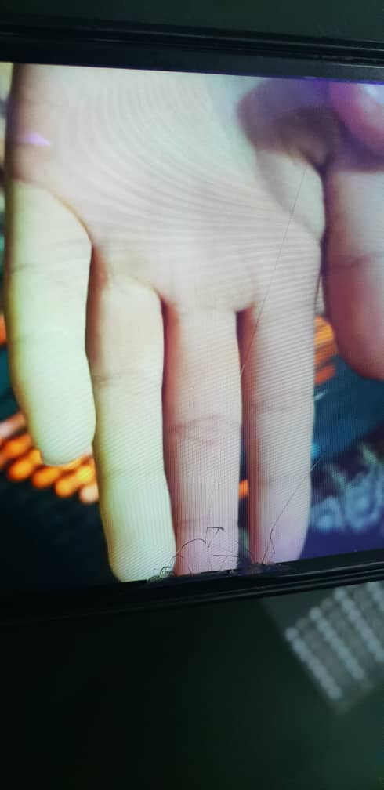

Slide 8
DISCUSSION
The classical Raynaud’s phenomenon has always been considered a warning of possible systemic disease. Although most cases are idiopathic, the list of conditions associated with this vasospastic response to cold is extended.
To the best of study in literature, a causal relationship between thyroid deficiency and Raynaud phenomenon has been reported in a few number of patients.
The first reported case of Raynaud phenomenon associated with hypothyroidism was in 1976; Shagan and Friedman described 2 patients with Raynaud phenomenon and hypothyroidism whose symptoms disappeared with thyroid replacement therapy.

Slide 9
It is believed that the pathogenesis of RP lies in the reduced digital blood flow due to excessive vasoconstriction. Because of decreasing the metabolic rate of all tissues in hypothyroidism, it is reasonable to expect less digital blood flow at any temperature.

Slide 10
The patient clinical scenario described here suggests an association of Raynaud’s phenomenon and hypothyroidism again and recommend that Raynaud’s phenomenon may be an early clue to the diagnosis of hypothyroidism.
The patient’s TSH levels was high (33 mIU/l) and Free T4 was lower than normal range (0.5 ng/dL). In also, she had significant color changes affecting all fingers and cold hands that presented Raynaud phenomenon.

Slide 11
The medical therapy with hormone replacement was stated again and in follow up the symptoms were remised.
This is the case report describing the association of hypothyroidism and RP and leads us to believe that Raynaud phenomenon may be an early clue to the diagnosis of hypothyroidism.
Although the history and the clinical picture of this report leaves little doubt about the diagnosis this association, further elucidations should have been done to evaluate the Raynauds phenomenon and hypothyroidism association.

Slide 12


