Slide 1
AMENORRHEA
Dr Ali Mazaheri MD

Slide 2
Primary amenorrhea
Primary amenorrhea is defined as the absence of menarche in ≥ 15-year-old females with developed secondary sexual characteristics and normal growth or
in ≥13-year-old females without signs of pubertal development

Slide 3
Primary amenorrhea
the absence of menarche 3 years after thelarche (start of breast development)
or 5 years after thelarche, if that occurred before the age of 10 years

Slide 4
Secondary amenorrhea
Secondary amenorrhea is characterized by cessation of previously regular menses for three months or previously irregular menses for six months

Slide 5
Notes:
LH stimulates ovarian follicular theca cells to produce androgens, which are converted to estrogens in granulosa cells by FSH-induced aromatase. Increasing estrogen levels in girls result in gradual breast tissue and uterine growth, pubertal growth spurt, feminine adipose tissue distribution and accrual of bone strength. The endometrium proliferates and eventually bleeds marking menarche. During the first postmenarcheal years, about half of the cycles may be anovulatory and irregular menstruation may continue for several years after menarche. The gradual maturation of the hypothalamic neuronal circuits by estrogens results in generation of the GnRH and LH surge that induces ovulation and regular menstrual cycles

Slide 6
Etiologies of primary amenorrhea
Etiologies of primary amenorrhea can be categorized as
hypothalamic or pituitary disorders causing hypogonadotropic hypogonadism,
gonadal disorders causing hypergonadotropic hypogonadism,
disorders of other endocrine glands
congenital utero–vaginal anomalies

Slide 7
The most common etiologies of primary amenorrhea have been reported to be gonadal dysgenesis, Müllerian agenesis, and hypogonadotropic hypogonadism

Slide 8

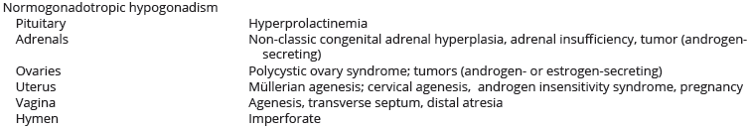

Slide 9
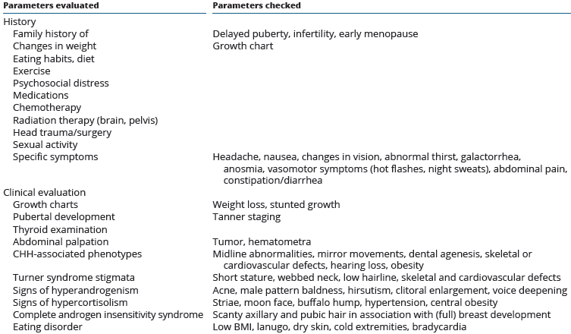
history and clinical evaluation

Slide 10
Evaluation
Pregnancy test should be taken
the absence of signs of androgen secretion
Signs of hyperandrogenism
Because hypoestrogenism is a significant risk factor for bone loss, bone mineral density (BMD) testing should be considered in hypoestrogenic states

Slide 11
Etiologies causing hypogonadotropic hypogonadism
Self-limited delayed puberty/CDGP
Functional hypogonadotropic hypogonadism
Notes:
50 to 75% of girls with CDGP have a family history of delayed pubertal onset
Functional etiology is found in approximately 20% of females with delayed puberty or incomplete pubertal development
In addition to life-style causes, for example, stress, excessive exercise or restrictive eating habits, also chronic disease (e.g. anorexia nervosa, inflammatory bowel disease, celiac disease, chronic renal disease, sickle cell anemia and cystic fibrosis) may cause HPG axis suppression.
Hypogonadotropic hypogonadism and FHA develop as an adaptive response to chronic metabolic energy deficiency
hypercortisolism, and elevated levels of proinflammatory cytokines may have an impact on the HPG axis.
Both corticotropin-releasing hormone (CRH) and cortisol suppress GnRH secretion.
Glucocorticoids also inhibit the effects of E2 in the uterus

Slide 12
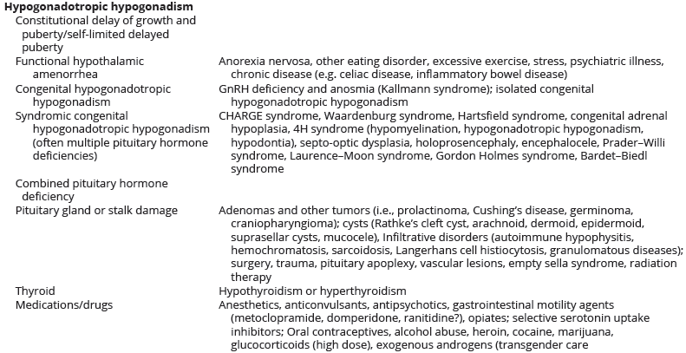

Slide 13
Functional hypogonadotropic hypogonadism
In a suspicion of FHA, review of the growth curves (typically weight loss and sometimes stunted growth) and a careful evaluation for psychosocial influences are essential
Chronic diseases have to be ruled out
Laboratory parameters typically reveal low or low-normal serum LH and normal FSH (usually higher than LH) levels
Serum E2 is typically < 50 pg/mL (184 pmol/L), but acute gonadotropin response to GnRH stimulation is preserved (defined as a two- or three-fold rise in LH and FSH compared with baseline levels)
Notes:
In FHA, BMD measurement is recommended after 6 to 12 months of amenorrhea before considering hormone replacement therapy (HRT)
After a reasonable trial of non-pharmacological therapy (12 months), short-term use of transdermal 17β-estradiol may be tried
The Endocrine Society suggests against oral contraceptives for the purpose of gaining menses or improving BMD, as they may mask the underlying pathology and bone loss may continue. However, oral contraceptives should be considered for patients at risk for pregnancy because ovulation may precede menstruation

Slide 14
Functional hypogonadotropic hypogonadism
in females with E2 consistently lower than 20 pg/mL (73 pmol/L), the response to GnRH is the only feature that may differentiate FHA from other types of hypogonadotropic hypogonadism
If no evident reason (e.g. weight loss) for amenorrhea exists, a GnRH stimulation test should be considered

Slide 15
Functional hypogonadotropic hypogonadism
In FHA, TSH and FT4 are in the lower range of normal, similar to that seen in any chronic illness
The increase in cortisol secretion is less than that seen in Cushing’s syndrome, and the circadian pattern is preserved
In patients with FHA and underlying polycystic ovary syndrome (PCOS), LH and FSH may be normal, E2 low and LH/FSH ratio elevated

Slide 16
Congenital hypogonadotropic hypogonadism
characterized by absent or incomplete puberty affecting approximately 10 to 20% of adolescent girls with pubertal delay
CHH is termed ‘isolated’ when no anatomical defects are found. Isolated CHH is typically associated with normal olfactory and GnRH neuronal development but impaired regulation of GnRH secretion
Notes:
The spectrum of phenotypes is wide from complete hypogonadotropic hypogonadism to partial hypogonadism with an arrest of pubertal development, reversible hypogonadotropic hypogonadism in some patients or normal pubertal development with secondary amenorrhea. However, only few case reports concerning females with reversible CHH exist

Slide 17
Congenital hypogonadotropic hypogonadism
Kallmann syndrome
mirror movements (synkinesis)
unilateral renal agenesis
Eye movement disorders
sensorineural hearing loss
Midline brain defects
cleft lip/palate
dental agenesis
Skeletal defects
cardiovascular defects

Slide 18
Syndromes associated with CHH
CHARGE (coloboma, heart malformations, atresia of the choanae, retardation of growth and development, genital anomalies, ear anomalies, olfactory bulb aplasia) syndrome
4H (hypomyelination, hypogonadotropic hypogonadism and hypodontia) syndrome

Slide 19
Syndromes associated with CHH
Waardenburg syndrome
Mutations in NR0B1 cause congenital X-linked adrenal hypoplasia that is associated with hypogonadotropic hypogonadism
Mutations in the leptin-receptor gene (LEPR) cause hyperphagia, severe obesity, alterations in immune function, delayed puberty and hypogonadotropic hypogonadism

Slide 20
Genetic testing is recommended for diagnosis, prognosis and genetic counselling in CHH
Its work-up includes cranial MRI to rule out tumors or other lesions,
ultrasonography to visualize the ovaries, uterus and unilateral renal agenesis, and a BMD measurement to evaluate bone health
Notes:
Serum FSH and LH may be undetectable low, or in those with partial pubertal development, serum gonadotropins and E2
In the evaluation of CHH, other pituitary hormone defects have to be ruled out by performing an exploration of the complete pituitary axis
Sense of smell should be tested with a standardized olfactory test, since 50% of those with CHH were anosmic or hyposmic despite self-reported normal sense of smell. Induction and maintenance of pubertal development are described later in this review

Slide 21
Acquired causes of hypogonadotropic hypogonadism
Tumors and cysts
the most common adenomas in adolescence are prolactinomas (46–66%), followed by corticotropinomas (30%), somatotropinomas (5–15%), gonadotropinomas, thyrotropinomas and non-functioning adenomas
craniopharyngiomas, germinomas, Rathke’s cleft cyst, Langerhans cell histiocytosis, and dermoid or epidermoid cysts
Notes:
Pathophysiology is usually mediated either by hypothalamus or pituitary stalk compression interfering with GnRH or gonadotropin synthesis or secretion, or by hyperprolactinemia via the interference of the inhibitory effect of dopamine on prolactin secretion
Brain MRI is indicated in a suspicion of a spaceoccupying lesion: severe or persistent headache, vomiting that is not self-induced, change in vision, lateralizing neurologic signs, thirst or urination

Slide 22
Other acquired causes of hypogonadotropic hypogonadism
Primary hypothyroidism
Renal insufficiency
Juvenile hemochromatosis
medication
Opiates
Neuroleptics
Typical antipsychotics
SSRI
metoclopramide and domperidone
Notes:
Primary hypothyroidism may cause moderate hyperprolactinemia via lack of negative feedback in the hypothalamus–pituitary–thyroid axis leading to increased thyrotropin-releasing hormone (TRH) secretion in the hypothalamus. Subsequently, TRH stimulates TSH and prolactin release causing hyperprolactinemia, which inhibits GnRH pulsation
Renal insufficiency may cause moderate hyperprolactinemia due to impaired renal degradation and clearance of prolactin, and increased prolactin secretion. The latter may be due to reduced lactotroph responsiveness to dopamine suppression
Opiates suppress LH secretion, resulting in low sex steroid production and clinical hypogonadism

Slide 23
Etiologies causing hypergonadotropic hypogonadism
Premature ovarian insufficiency
Turner syndrome
46,XY gonadal dysgenesis
ovarian dysgenesis
Notes:
Premature ovarian insufficiency (POI) is defined as menstrual absence or irregularity with elevated gonadotropin levels on two occasions separated at least 4 weeks apart and low E2 levels before 40 years of age
In a suspicion of non-iatrogenic POI, chromosomal analysis is a key diagnostic test to rule out Turner syndrome and 46,XY gonadal dysgenesis. If chromosomal analysis is normal, screening of 21-hydroxylase antibodies (or adrenocortical antibodies) and thyroid peroxidase antibodies should be considered
FSH level over 10 IU/L at 10 years of age in Turner girls is considered to be a sign of ovarian failure and an indication for pubertal induction from the age of 11–12 years
Ovarian cysts may be present in both conditions (17-hydroxylase deficiency, Aromatase deficiency) due to high gonadotropin stimulation. In contrast, ovaries in girls with FSHR mutations are small and follicular development is halted to primary stage due to the block in FSH action

Slide 24
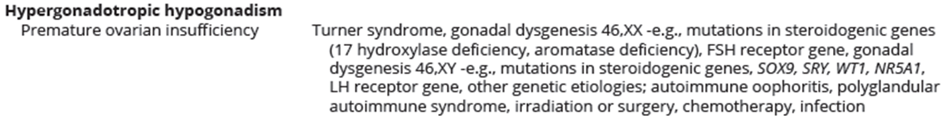
Etiologies causing hypergonadotropic hypogonadism

Slide 25
normogonadotropic hypogonadism
Androgen excess
PCOS
Non-classic congenital adrenal hyperplasia
androgen secreting tumors of adrenal
endogenous Cushing’s
Syndrome
exogenous Cushing’s syndrome
Anatomical causes
Notes:
In PCOS adolescents, primary amenorrhea has been associated with more severe metabolic disturbances
Non-stimulated, early morning level of 17-OHP >6 nmol/L is suggestive of NCAH and should be controlled with an ACTH stimulation test: stimulated 17-OHP level >30nmol/L at 60 min is diagnostic for the disease

Slide 26

normogonadotropic hypogonadism

Slide 27
Anatomical causes
Imperforate hymen
Distal vaginal atresia
Transverse vaginal septum
Cervical agenesis
Müllerian agenesis
Notes:
Cervical agenesis may be isolated but is often associated with vaginal agenesis

Slide 28
case
A 16 years old male
Micropenis
Testis 2
central obesity
gynecomastia
eunuchoid body habitus
no facial hair
high pitched voice
no skeletal abnormality
no axillary hair
pubic hair: villous and scanty

Slide 29
case
prolactin= nl
TSH= 2.3
cortisol= 14.6 µg/dl
Lh=0.1 mIU/ml
FSH=0.2 mIU/ml
Testosterone= 223ng/ml
ht= 175
wt=79
BP=126/80
BA=14
Abdominal sonography= nl
Karyotype= XY

Slide 30
case
BMRI = absence of bulb and olfactory grooves on both sides

